Slide 1


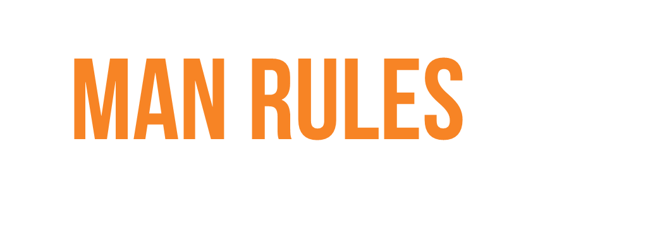

Scoping the norms of New Zealand masculinity

Slide 2

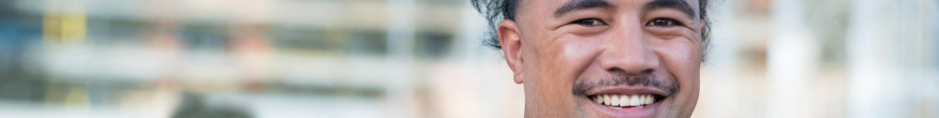
About this
study
Summary of
key findings
Part 1:
The changing world of men in New Zealand
Part 2:
The rules of being a man in New Zealand
Part 3:
The spectrum
of response to these rules
Part 4:
The impact upon help seeking
Part 5:
Engagement with help seeking for domestic abuse
Part 6:
Reframing
the rules
Part 7:
The way
forward

Slide 3

New Zealand has a problem with abusive behavior in intimate partner relationships. One in three women are estimated to be exposed to physical or sexual abuse in their lifetime*.
Thanks to campaigning efforts in the last decade, New Zealanders are clear that domestic abuse** is not OK. And yet the problem persists.
This study is part of a wider understanding of the influences of the gender system on gender norms and expectations within intimate partner relationships.
Evidence from overseas*** shows that the presence of unhealthy masculine norms are correlated with factors associated with the practice of violence.
As a nation, we face the uncomfortable truth that abusive behavior in intimate partner relationships is not just in the homes of our perpetrators but in the soil of our masculinity.
This study set out to investigate how norms within the gender system impact upon what it means to be a man in New Zealand.
The men in our study shared widely held masculine views around the expectations and roles of men. We wanted to understand how those expectations and roles played out for them – how they felt, how they behaved and particularly how this impacted on their propensity to seek help in the context of domestic abuse.
*https://nzfvc.org.nz/data-summaries/snapshot
**Note on the term ‘domestic abuse’. We have used this term to relate to harm between those in intimate partner relationships, including (but not limited to) physical harm, emotional harm and coercive control. We recognise the limitations of this term (and discuss the inadequacy of current language later in this study).
*** See the Victorian Government’s Framework Foundations 1: A review of the evidence on corelates of violence against women and what works to prevent it.

Slide 4
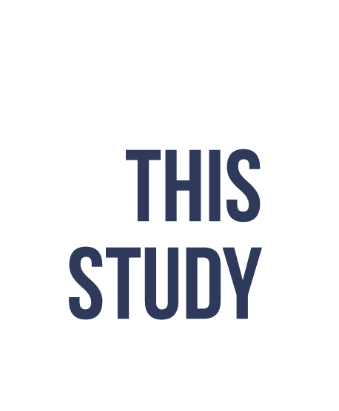
Our study engaged over sixty men from all walks of life in New Zealand. Forty of them joined each other in an anonymous online forum, and thirty-six participated in sit down conversations hosted by experienced men’s practitioners.
Throughout, they did something the normally won’t do - they opened up. Not just about their day-to-day lives as men, but about their struggles, their relationships, their dark moments, their hopes and their fears ….
They did so with perfect candour, and gravity and respect for each other. Men talked, and they also listened.
They gave us an up close, intimate and candid snapshot of what it is like to be grappling with ‘being a man’ in New Zealand today.

Slide 5


PART ONE
PART TWO
Qualitative online forum spanning 3 days with 40 people
12 x triad discussions
(3 participants per discussion)
July 2020
August-October 2020
Men from all over New Zealand took part in the Qualitative Online forum.
All men who took had attitudes that indicated a strong identification with masculine norms. Some had exposure to violence at some point in the past but they were not recruited for this.
These discussions took place in Auckland, Wellington and Gisborne, with a mixture of both face to face and Zoom discussions. They were conducted by Colmar Brunton moderators alongside experienced men’s practitioners.
COLMAR BRUNTON 2020
5

Slide 6
PART ONE
PART TWO
Qualitative online forum spanning 3 days with 40 people
12 x triad discussions
(3 participants per discussion)
July 2020
August-October 2020
Re-recruits from the online forum n=15
Not recruited from the online forum n=22
Wellington n=10
Auckland n=13
Tauranga = n=3
Gisborne n=8
Christchurch n=3
Maori / Pasifika n=8
A total of n = 40
18-30 y.o. n=20
31-45 y.o. n=20
Maori/Pacifika n=11
Asian decent n=9
COLMAR BRUNTON 2020
6

Slide 7
Throughout this document, names have been changed to protect identities but the words are their own
Happy wife, happy life…Shit my wife just walked in and I got a fright writing this ☺
Teo

Slide 8


“Maleness” has become confusing and very highly charged. Men are often stuck between conflicting messages. and feel like they can’t get it right.
Even though they may recognise their privilege, they feel that they receive little empathy for their struggles.
Women are the key emotional outlet for men. Mates cannot always be relied upon to be a source of support.
Today’s men are motivated to be better fathers for their sons; this includes greater emotional closeness and better emotional role modelling.
The ‘rules’ required of men in New Zealand are firmly established yet clash with modern ideas of equality and emotional vulnerability. Both men and women reinforce these rules.
Shame makes men vulnerable, not just weak, and is a key part of why men may not seek help.
Those who are more sensitive to weakness are more likely to be trapped by the rules and more likely to fear shame.

Slide 9

Help seeking is asymmetrical – men seem more comfortable with offering help than seeking it.
Many men prefer to use a ‘DIY’ approach to addressing their struggles. This avoids potential exposure and showing vulnerability.
A lack of skills to express themselves, poor working knowledge of options and previous poor experiences also keep men from seeking help.
Mental health has made some inroads in encouraging men to seek help, but admitting to or even acknowledging family violence is still taboo, even if they may have some degree of private empathy for the man’s situation.
For communications, any suggestion of shame (even addressing it as a barrier) risks deepening shame.
Men prefer – and spontaneously suggest – a positive, strength based framing around encouraging men to take action for themselves.
What men desperately want is to be given a blueprint of how to begin the conversation and some permissibility to do so.

Slide 10

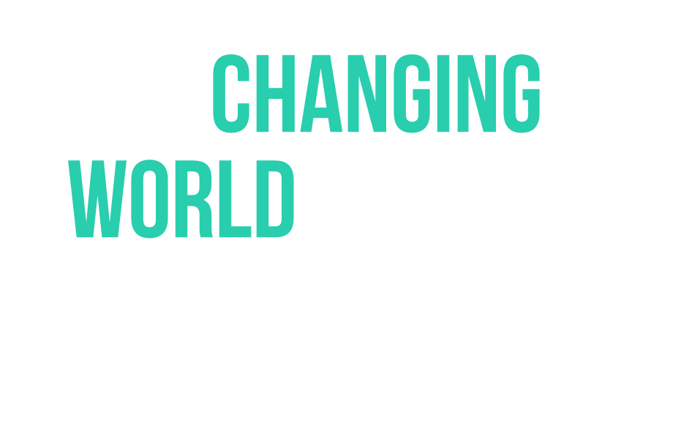
Part 1:

Slide 11
Being a man in today's world feels like a mixture of responsibility, pressure and shame.
Max

Slide 12
A changing world has meant that many men are feeling unsure of what is expected of them.
You can’t get anything right it seems… Everyone says “man up”, and then also say “ew yuck toxic masculinity” and “rugby is just an outlet for white male rage”. It is bloody tough balancing the two issues. Victor
Sometimes it feels like I'm stuck between two worlds of being a macho type kinda man and the new softer, 'more open and in tune with his feelings' man. And anything I do, will get criticized by the other side. Tane
Right from the start of our discussions, it was clear that there is a lot of confusion among many of the men about the socially acceptable way of expressing masculinity.
Many expressed feeling stuck between conflicting messages: experiencing an ongoing tension between the seemingly contradictory messages of ‘man the hell up’ and ‘soften the hell up’.
While some men had been able to formulate a masculine identity that encompasses both, the majority of men in this study expressed an ongoing struggle to navigate the need to be more open and willing to ‘talk’ with the need to be perceived as ‘strong’ before others, which we will explore in more detail later.
The issue for many men is that neither ‘the hard man’ or ‘the sensitive guy’ feel wholly authentic. Men in the study articulated feeling stuck because they feel there is pressure to choose and identify as one or the other.

Slide 13
They felt that “maleness” has now become confusing and very highly charged
Most men are not naïve. They understand and, in many cases, celebrate the changing role of women in our society.
However, there is a vocal cohort of men who have the prevailing feeling that change has happened to them, not with them. While some men have developed strategies to navigate this change, others feel left behind, undervalued and misunderstood. Many of the men we spoke with felt that they are excluded from the conversation.
These societal changes, seemingly imposed from outside, have brought more than a tinge of resentment to many of the men in our study. The prevailing feeling among these men is that masculinity is ‘under attack,’ and uncertainty around how to behave in a way that doesn’t appear ‘toxic’.
Most men are both aware of the privilege they have as men (and most particularly as white men), and the stresses inherent in living up to and ‘defending’ notions of masculinity. They may recognize that they are privileged by the system, but they quite often feel individually betrayed by it.
I feel that the role of today's man has become a difficult and confusing one. To be a masculine figure in today's society seems to imply that one is oppressive or toxic. Ryan
There is definitely a feminism swing these days and all about women and what they want. I'm all for equality but this is definitely taking away from men and what men should be. Dylan
I feel that we are enemy number one, the amount of shit going on in the world I honestly feel like I’m looked down upon where ever I go. Noah

Slide 14
In some cases, this is creating a feeling of double standards
Sometimes this creates the impression amongst men that they are being held to account by two different, and conflicting sets of rules.
For example, men are quick to point out the modern requirement to treat women as equals, but also the legacy requirement to be their provider and/or protector. Or how the same behaviour can be celebrated amongst women but deemed disgusting when men do it. It leaves many men with a sense that they can’t ‘win’.
Society in general, and women in particular, are often felt to lend a hand in reinforcing this double standard. Many men talk about experiences of following the ‘new rules’ but not being rewarded for it.
Women are as much enforcers of this as men sometimes. There's also a lot of women out there that just want a strong, stereotypical manly man that never shows any vulnerability whatsoever Immanuel
Men still have the same gender expectations. They still lowkey are expected to be the breadwinners if the women can't or doesn't have a good job. They are expected to be strong in the tough times for everyone in the family. They have to keep their woman happy or else she will leave him for another man who can. Jake
The risk of having sex with any woman is just way too high. If she didn't enjoy the sex or just doesn't like you in the near future all she has to do is contact the police and your entire career and personal life falls apart. Josh

Slide 15
Many men feel that the world is not giving men empathy; and yet they crave it
Many men articulated what they perceived as a lack of sympathy for their problems. Many had an abiding feeling that society does not care how men feel.
The struggles we heard about in the forum were not insubstantial – mental health, relationship issues, porn addiction, loneliness… – but these same men had the abiding sense that if they speak up about their struggles as men they get shouted down or ridiculed.
For some, their current outlet to find the empathy they seek is in chat rooms and other groups of men who agree with them and reinforce their resentments. Echoes of men’s rights activists such as MGTOW* were present in our forum.
But more hopefully and substantively, the extensive and constructive response that we got to our forum indicates that the vast majority of men are more than willing to talk about issues around masculinity – in fact, given the right context, they are craving it.
*Men That Go Their Own Way
It feels more and more, that to have an opinion that males don't have everything easy and that we have our own unique set of struggles is somehow devaluing the struggles of minorities or of females. Ryan
Sometimes can’t say what you want to say because it will be perceived as complaining – it’s hard to say that I need a break or I need a bubble bath. Anonymous group attendee
How dare we complain about our struggles as men, when we are at the top of the power hierarchy? Andrew

Slide 16
Changing gender norms have impacted three key relationships differently
With partners
As fathers
With
or as mates
SOME CHANGE
Men’s relationships
LESS CHANGE
SUBSTANTIAL CHANGE

Slide 17
The mates relationship: still mostly centred on distraction and having a good time
In spite of efforts to get men to open up to each other, many men still do not have a close emotional relationship with friends to be able to talk with them in times of need.
Mates are often more about distraction and having a good time. Mates serve as a source of entertainment and physical help – talking with mates can actually make some men feel worse because the conversation rarely goes beyond the superficial and can leave men feeling exposed to their mates without having the core issue dealt with.
Amongst younger men we did find a much greater degree of closeness and willingness to support their friends. Not everyone had this, but those that did talked about their relationships with their friends more akin to how those in close relationships talked about their partners.
The mate relationship [is] surface level only with guys and conversations centred around movies, games, sports etc without too much depth. Julian
The relationship I have with my best mate is great and I can talk to him about girls and mutual interests and all the other stuff I don't usually talk to my girlfriend about. I can't open up with him like I can my partner but it's still great fun anytime we hang out. Immanuel
I do not feel as much has changed here, although I would definitely be more open and breach topics with mates now than I would've 10 years ago for example. Dylan

Slide 18
The partner relationship: first port of call and source of comfort in times of need
Clearly, our men recognised changes in the practical roles of men and women – for example, with more women taking on ‘bread winning’ and men taking on a greater share of care giving. But the emotional role of women as the safe harbour for men showed that men are still often surprisingly reliant upon their partners as one, if not the only, person they could be their whole self with.
Partners (in good relationships) are precious because they are the one place where they can open up. Partners often listen, interrogate and try to understand – something that mates often aren’t equipped to do. Mothers can also play this role.
Problems may arise when the person you are having difficulties with in your relationship is the same person you rely upon as your confidante.
Many men fear the breakdown of relationships because of losing this connection and their only support person. Furthermore, they fear the risk of the vulnerability they have shown coming back to bite them.
Funny I remember drinks with the boys recently, and this topic came up and in drunken confession we all admitted that a kiss on the forehead from our loved one fixes everything and completely disarms us. George
With your partner, you want to tell her that you're totally equal in the relationship. But you don't want to actually be equal; if you let her take on a full half of the responsibility then she'll leave you because you don't provide for her and what are you worth then? Jake

Slide 19
The father-son relationship: desire to be better men for their sons (and for their sons to be better men)
Fathers are the formative influence on shaping most men’s idea of what it is to be a man, but most men are acutely aware that their father does not provide all the answers.
The men in the study who are aware of their father’s shortcomings often have sympathy for him (he was a product of his time) but often articulate not wanting to become who he was or replicate his mistakes.
For these men, the legacy they have been passed from their fathers about masculinity is often about minimising their feelings and hiding who they are.
However, there has been a fundamental shift in where men are with their fathers vs where they are with their sons. There is now a general sense that there is more permission to be loving and involved with kids, and the men in the study find this liberating. This is not always easy - how can they pass on something they did not have?
Fathers still want (for the most part) for their kids to have ‘masculine’ traits (respect, backbone, capability) but to this has been added a desire for their kids to be more able to navigate the world with more openness.
We didn't hug our father and the word
love was rarely used. This has definitely
changed for the better over the years. Miles
I know I will never, ever lay a hand on my kids because I know how shitty it is to grow up in that environment and I would sooner die than lay a hand on my partner either. Immanuel
In the past, kids would always feel that the fathers would be the authority who should be always right and correct. But today’s relationship is more like friends. Fathers and sons would prefer to talk more about feelings, and try to understand “where they come from”. Jack
Growing up as a pacific islander we never ever spoke of our feelings and that in hindsight is tragic. I know suicide within my community is high and that's because no one these kids love and respect lets them express themselves and ask for help. George

Slide 20
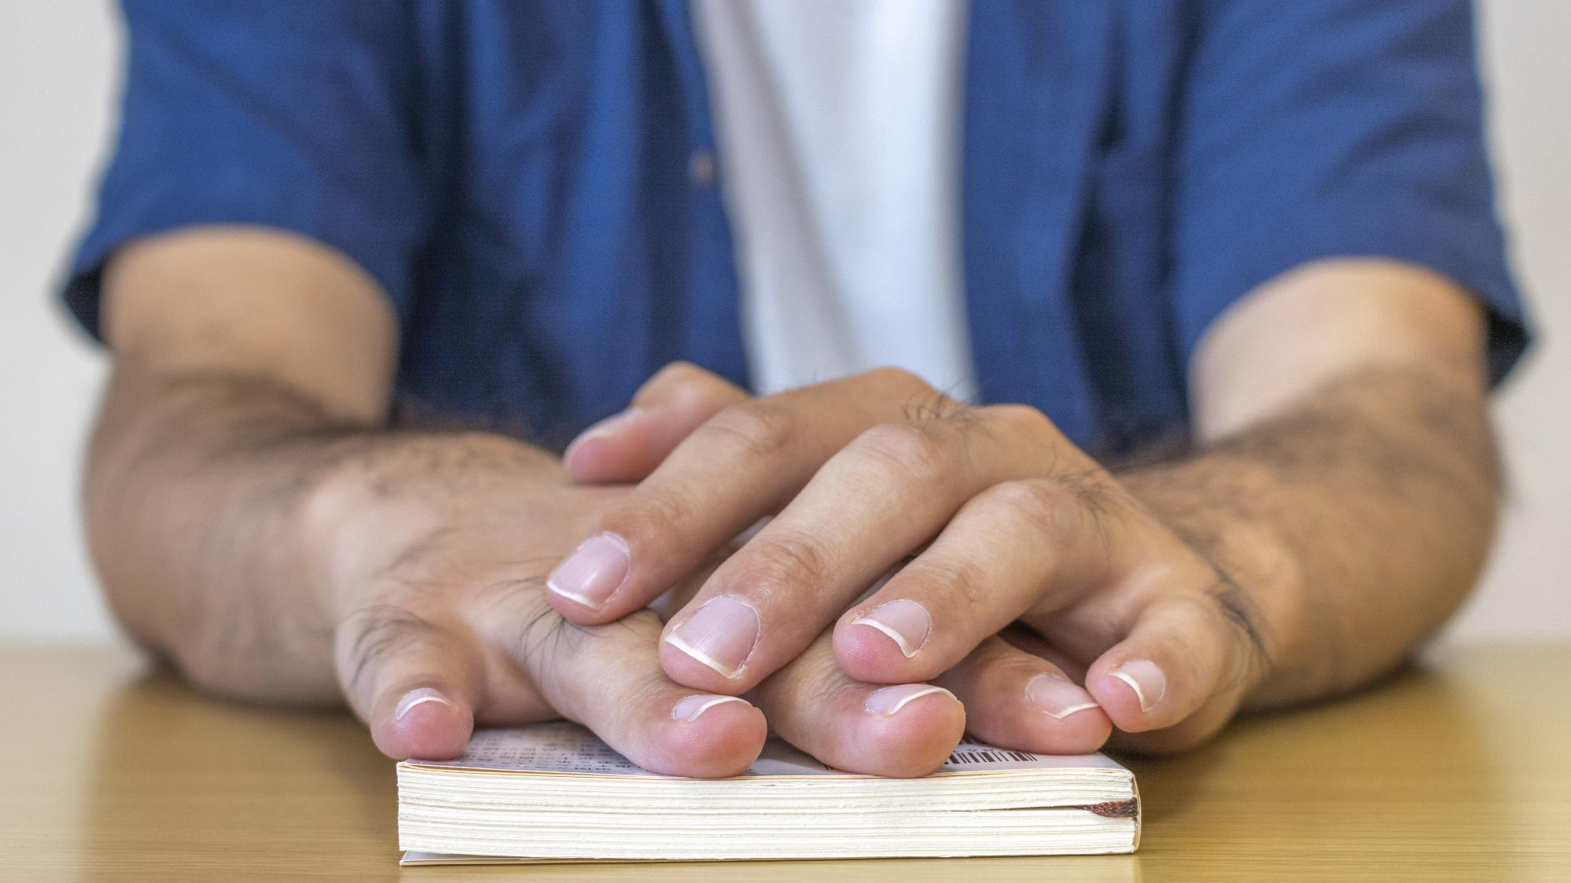

Part 2:

Slide 21
I think these rules have been around for ever, and I don’t think they will change much.
It’s just how it is.
Teo

Slide 22
Masculinity in New Zealand continues to be rooted in a powerful belief system centred around the expression of strength as the defining characteristic of masculinity
It was important to most of the men in the study to feel and present themselves as ‘strong.’
Although the expression of this characteristic may be changing in recent times, this singular underlying quality of what it means to be a man would no doubt be recognisable to our respondent’s fathers and grandfathers. This is a quality that they often also they hope their sons will exhibit.
So whilst the world that they are operating in has changed substantially, the core of what it means to be a man hasn’t changed as much.
Most of the ‘man rules’ (overleaf) that our respondents came up with directly relate to the idea of strength.
I believe in mental toughness, stoicism and personal responsibility more than anything and I think that's true for most guys. Above all, I am the master of my fate and the captain of my soul. That's probably why I aspire to the ideals embodied by men like David Goggins, Jocko Willink or Marcus Aurelius. I know I still need work and could always do better but strong men like those are what we need more of in our society. Men should be able to be open about their feelings but not in a way that makes them seem weak. You can be real and talk about these things without becoming a blubbering mess. Immanuel

Slide 23

A MAN SHOULD…
Be
capable
of dealing with shit
Be in
control
of his emotions
Be a
provider
for those close
Be a
protector
for his people
Be in
solidarity
with other men
Be
uncomplicated
to deal with
THIS IS STRENGTH AND EQUALS ‘SUCCESS’

Slide 24
The ‘rules’:
How they play out
QUALITY | HOW IT PLAYS OUT | IN THEIR OWN WORDS
Capability | Deal with ‘shit’ – from others, from life. Shoulder burdens. Work things out for yourself. Be dependable for those around you. | Don't ask for help. If you do ask for help, only ask if you really need it. Jake Don't really talk about your issues, until they pop. Murphy Men like to figure things out for themselves, not be told by someone else. Its a pride thing. Irvin You should know your stuff. Jack Don't be a pussy (I.e. take on a challenge or don't give up). Tane
Control | Don’t lose control of your emotions. Never cry in front of others (except in exceptional circumstances). Never show that you’ve been wounded – stay tough in the eyes of others | Feelings are for girls - it keeps coming back to this right. Andrew No one wants to see your tears. Vidu Men should be able to be open about their feelings but not in a way that makes them seem weak. You can be real and talk about these things without becoming a blubbering mess. Immanuel
Provider | Be a resource for others – practical, financial, emotional strength. Be a support - increasingly an emotional provider for kids and close friends. | Men need to provide for their families, and failing to do so would make you a failure as a man. Andrew If you let her take on a full half of the responsibility then she'll leave you because you don't provide for her and what are you worth then? Jake
Protector | Take care of the people in your life – you need to be someone they can depend on | Be the protector of your partner and female friends. I'm a pretty big guy so if a female friend is walking home I'll go with her to make sure nothing happens to her. Immanuel
Solidarity | Stick with your mates. Don’t nark. Don’t denigrate masculinity. | Don’t dog the boys (I.e. don't tell your partner or anyone's partner anything that would get the boys into trouble) Tane
Uncomplicated | Do not make others uncomfortable with your problems. Do not burden others. Do not draw attention to yourself unnecessarily. | Don't talk about your physical intimacy with others. Tane Don't talk about sensitive topics like addiction, depression and death, things that might make others uncomfortable. Julian If talking to another male, you cannot talk in-depth about your relationship with your partner. Murphy We're expected to handle our own marriage affairs. Teo

Slide 25
If a man is following the rules, he seems to do better in the world. If a man doesn't follow the rules, he seems to suffer some negative consequences. Nobody admits those consequences are because he didn't follow the rules, but for men who are paying attention, it's pretty clear that's what happened.
Jake

Slide 26
The flip side of the strength based ‘man rules’ is the spectre of weakness – and shame.
THIS IS STRENGTH AND EQUALS SUCCESS
Capable
Control
Provider
Protector
Solidarity
Uncomplicated
Fear
Fear
Fear
Fear
Fear
Fear
Disappointed expectation
Exposure
Humiliation
Failure
Exclusion
‘Drama’
THIS IS WEAKNESS AND EQUALS SHAME

Slide 27
Shame comes in many forms – and men avoid it whenever possible
The spectre of weakness is so strong for the men we spoke to in this study because it brings the prospect of shame. Shame is something these men feel when they don’t measure up to their own standards or the standards of others – it’s the feeling that ‘I’m not good enough’, and that ‘I will be exposed for it.’
All the men in our study connected the ‘man rules’ with shame, and saw the avoidance of shame as the driving force behind the masculine belief system and behaviours. Even the most confident-seeming men were still somewhat pinned in place by the prospect of shame.
Shame comes in many forms. It isn’t merely the threat of public exposure for wrongdoing, but the contravention of the ‘man rules’. Being incapable of dealing with difficulties brings shame, because it exposes you as not being capable; losing emotional control brings shame, as it is associated with humiliation; not being able to provide for others disappoints other’s expectations of men, and hence brings shame, and so on.
Shame is something that is feared publicly and felt personally. The worst shame is public shame – shame is bad enough in private but unbearable in public. But many men also spoke of an abiding sense of shame for things that they had never revealed to other people.
Men directly spoke of hiding feelings and actions that they thought would engender shame. Indirectly, these men often downplayed events that might trigger shame, or sought to justify their actions in order to sidestep the prospect of shame.
I made the mistake of telling the full truth. I admitted that I felt insecure and weak in a certain area. I got emotional. Jake
I felt a lot of shame and dread when I opened up to my partner for the first time. Tane

Slide 28
Shame is a vicious cycle - it makes men feel more vulnerable
Shame is not just a consequence of something, but something with consequences.
Looking shame in the eye is very, very challenging concept for the men we spoke to in this study, not least because by admitting to shame you make yourself more vulnerable to other people exploiting your shame, or at the very least, not wanting to be affected by your shame.
Shame makes men feel vulnerable, not just weak. It has too high a cost – it may come back to bite you: ‘easy for people to take advantage’, ‘blow up in your face’, the risk of being turned into a (literal) joke.
Thus, shame has a double jeopardy – the risk of exposure, humiliation, exclusion inherent in the shame itself, and the risk of it being used against you. Some men spoke of a quasi ‘shame hangover’ where they dreaded the consequences after the event.
Once shame is admitted, there is no going back. It’s a risk that many men aren’t willing to take, without some iron clad assurances that the gains associated with being vulnerable outweigh the risks of exposure.
I think a lot of harmful behaviours by men towards partners are driven by insecurity. From seeing the effects of their harmful behaviours it causes them further negative emotion such as shame, guilt, and embarrassment which makes it even harder for them to seek support. Murphy
If I ask for help every time I've got a problem, I am a weak man, and weak men do not do well in the world. Jake

Slide 29


Part 3:

Slide 30
Not all men respond to the rules in the same way
Of course, not all men are the same.
The men that we encountered during the study grappled with the rules and the evolving role of men in a variety of ways. We encountered men who were quite deeply resentful, some who had found an alternative route for themselves, some performers who felt capable to straddle the effects, some who had reformed to better fit their new view of the world, and some who were quite simply a little lost.
NB The categorisation of these attitudes, though revealing for the use of analysis, does not assume a value judgement of the attitudes or individuals involved.

Slide 31
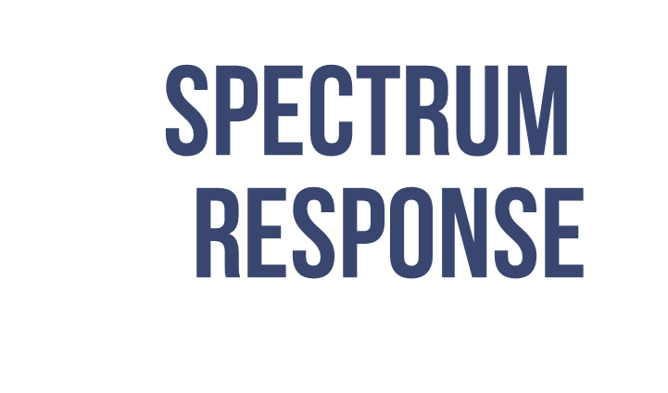
It’s all bullshit
George
It’s just how it is
Teo

Slide 32
Underneath the spectrum of response, sensitivity to weakness seems to be the driving force
The spectrum of response allowed for the emergence of five broad archetypes – Reformed, Alternative, Performers, Lost and Resentful across our sample. Amongst those Lost or Resentful, traditional masculinity norms were strongly present, broadly accepted and frequently used against them (by other men and women alike). Performers were also invested in these norms but use them more as a template for success. Those who were Alternative are secure enough to disengage from these norms. Only the Reformed see them as something to overcome.
The nuances of their perception of weakness were different and seem to drive where men sit on the continuum of adherence to masculinity norms. Those most trapped by masculinity norms had a tendency to see weakness as a vulnerability that would be exploited by others.
Reformed
Alterative
Performer
Lost
Resentful
Relationship with masculinity norms:
Overcome
Disengaged
Invested
Buffeted
Trapped
Relationship with weakness:
Weakness can
sometimes be strength
Weakness can be acceptable
Absence of weakness is a success
Weakness
is an exploitable vulnerability
Sensitivity to fear of weakness
Sensitivity to weakness

Slide 33
The rules are like a voice that keeps telling you not be weak. The rules are like an overwhelming feeling that constrict your thinking. The rules are like sign that springs up every time you want to seek help but divert you else instead.
Manaia

Slide 34
The resentful:
“I feel that we are enemy number one”
Those with resentful attitudes appear quite heavily invested into masculine codes and traditional masculine ideals, and hence perceive challenges to these ideas as a challenge to their sense of self.
They tend to see the changing role of women as a zero-sum game, with a corresponding loss to men.
There’s a sense from these men that men increasingly are outsiders in a world that no longer respects who they are or what they stand for (“I get looked down upon wherever I go”).
The object of their resentment is not particularly the changing role of women, or women themselves, but more what they see as the proscribed activities that have come as a result – particularly being able to “speak their mind”. They are also particularly sensitive to accusations that they are not ‘doing their bit’ – believing that they are making efforts yet but perceive that they are not being acknowledged for doing so.
For their sons, they continue to believe in the value of ‘masculine qualities’, particularly giving and receiving respect and hope that society will find a way for them to do this.
I feel men are required in today's world just to produce humans. Vidu
It seems that anything you try to do that is considered "male" today is seen as toxic masculinity. Troy
It's like everyone is trying to second-guess what men do and reprimand them if there's a fault found in the action or the intention. Nickolas
[For his son] Hardworking ,respect everyone and fear no one, don't give up when the going gets tough and when it gets tough dig deep don't let whatever the task is beat you. Noah

Slide 35
The lost:
“It’s pretty confusing to be a man today”
Those with ‘lost’ attitudes do not rally against the perceived injustices of an increasingly feminist world, but are clearly and firmly pinned into place by masculine beliefs. They find themselves like a dog with two masters, looking for direction but finding confusing signals.
They often talk of having sympathy for opposing points of view but have no way of reconciling them.
They seem to be very highly influenced by the judgement and actions of other people. They are keenly aware of the need to fit in, to behave in a certain way and to ‘follow the herd’. They crave direction. Their language is littered with references to what is ‘required’, what is ‘right’, what is ‘pressured’.
Many of them spoke of strong (and open) relationships with close friends, but greater hesitation in more general social settings to put themselves ‘out there’. They have a deep desire for their sons to be able to reconcile these points of view – to be open minded, expressive, their own man, but to do so in a way that would not risk social consequences.
Those with ‘lost’ attitudes are looking for direction and a way to simplify a confusing landscape. Some are finding it in men’s forums.
I guess it feels like
you can never go about
things the right way. Like if you don't like someone’s opinion, you're a bigot, if you agree with them you're a sheep. Dave
No one likes to be teased etc so I guess its easier for young teenagers etc to just follow the herd rather than be themselves sometimes - I can admit to doing this at times. Sean
I feel required to stand a certain way or hold my beer a certain way. Ryan
The few rules he [my father] did not teach me are taught by social ridicule. If you are doing the wrong thing you'll learn pretty quickly what the right thing to do is. Temuera
I would like my son to be open minded and expressive yet still be able to stick up for himself. I think these are all important aspects but they could conflict with each other. Scott

Slide 36
The performers: “If you don't fit the mold then you don't get the rewards”
It’s hard trying to be a traditional
male in today's world, ie the strong silent type, involved in sport, the bread winner, the decision maker for the family. Irvin
I learnt to be strong and stoic because my family needed it. I came from a very dysfunctional family that lurched from crisis to crisis, often self inflicted, and they needed someone to show calmness and a rational response. Murphy
Sometimes so much of things are going inside you (like having a bad day in office, financial problems) but you have to show a brave face, act normal as if nothing has happened. Roshin
I think we all wear masks, and we wear different masks in different situations. We might bluff and bluster with our mates more so than our wives and definitely more than in front of our children. We are probably more likely to try and be strong in front of our mates than we are in front of our wives. And we probably always try be stoic in front of the kids no matter what is going on. Murphy
These guys often describe themselves as ‘traditional men’ and along with that identity, they also strongly subscribe to the ‘old rules’. They are much more cognizant of the rules and how to use them to their advantage and as the way to success (or a most certain route to failure if you do not live up to them). They were the smallest group in our sample.
They will change their behaviour depending on what the situation requires.
Of all of the attitudes, this group seems to talk most about masculinity being a performance or a ‘mask’ you wear This is merely accepted as part of being a man. They are also ‘players’ in the sense of competing and playing the game of being a man, and abiding by the rules to be successful.
They are heavily invested in showing strength and confidence, both for their own benefit but also for those around them. They believe that “men are attracted to challenge and discipline”.
They want their kids to be confident, respectful, to value hard work and to be the best that they can be – very much qualities that they ascribe to themselves.

Slide 37
The alternatives:
“I don’t buy into these expectations”
I feel I do have permission to
step outside these expectations,
however the consequences of doing this may change how others perceive you. Julian
I find the more I step out of these expectations, the more other men see that there is an alternative to the mold. Max
I've met a few straight men that kind of broke the mold in this way and to be honest it'd probably be better for them if they were gay because then you don't really have to adhere to these standards. Immanuel
I really find the more honest you are with people the more you get back. Miles
The representation and ideology of characters and figures (movie characters, parents etc) that we have looked up to all our life. It is often that we only see them in their lightest and best moments, being strong and what not. Sean
[For son] Having a strong mind to thing for himself and not be swayed by the popular crowd or vote to simply fit in. Julian
There were some men in our study that exhibited attitudes which showed a degree of disconnection from masculinity norms. Some of these men are opting out of the game by not buying into many of the gender norms that they see around them. In many cases, they just seem less invested in the old way than other groups.
Most markedly, these men frequently pinpointed a much broader set of sources for these norms. They had a critical view of cultural influences and could see the impact of them, in an almost philosophical sense.
They see the ‘mold’ for what it is; though instead of breaking it, they decide not to fit into it. Sometimes this seems to be because they are openly gay, which gives them freedom from the restrictive gender norms associated with men.
There are few hints of traumatic experiences or life challenges in their responses. Instead, they seem to have benefited from strong role models and security that has left them less exposed to the judgement of others.
Their hope for their sons is to become their ‘own man’, free from the pressures of trying to fit in with what his peers and the media expects of him. They talk about their sons having openness and empathy, though they recognise this is not an easy path.

Slide 38
The reformed: “What kind of man do you want to be”
The "rule of being a bloke" in New Zealand are for idiots and those same rules are killing us, wrecking our relationships, our families, losing us jobs and careers and homes. I don't give a fig about them anymore. They've done me no good. Arnold
I ended up doing a course that help forced you to let your guard down. The flood gates opened up. I cried almost everyday for a month. It healed me. Dean
here's a bunch of generic societal expectations of men that force you to abide by them or strive to be like them - which I whole heartedly disagree with. Ilijah
I'm different when it comes to my boys. I hug and kiss them ALL THE TIME. I've told them that I'll be like this their entire life! Hahaa. Manaia
This group of men all seem to have been on a similar journey, where a moment in life had brought about a reappraisal of their self and how they are affected by the masculine norms around them. Many had come to a place where now they were prepared to ‘call bullshit’ on some of these norms, because they have lived these, but now have learned another, ‘better’ way. Their language of rejection is far stronger than other groups.
The reformed have learned alternative expressions of masculinity, and they have a language and a discourse that empowers them to talk about it with others.
Getting to this place seems to have involved a good degree of hard work and challenge, and often some difficult decisions to leave certain aspects of their previous lives and thinking behind. In many cases, there is a sense they ‘turned themselves into a project’.
They have a degree of perspective on what it means to be a man and where these pressures stem from. They stress the idea of thinking for yourself and not simply passing on what others expect.
It might be easy to think of them as ‘home free’, but these men are still mightily aware of the pressures of social norms upon them. They are not free from them, but they are the group that seem to be most open to giving a hand-out to others who they recognise as being in a bad place.
They also do not reject masculinity wholeheartedly – they continue to see a lot of value in some aspects (protection, respect, strength) but particularly want to drop the emotional stoicism.
Therefore for their kids, they are looking for them to show kindness, respect, strength for others. Many are consciously role modelling being different father figures to their kids to the type of upbringing they had.

Slide 39
What became clear as I got older is that all of these thoughts and ideas that I had about being a man were all passed to me. They were all perceptions that other people had
of what it means to be a man!
Manaia

Slide 40
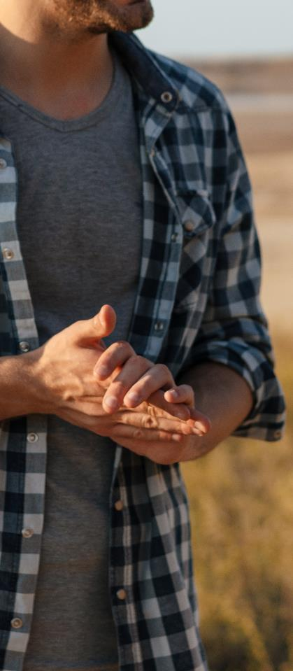
The more we talked about ‘the rules’, the more men started to critique them
This discussion moved men on from their starting point around the perceived injustices of a more ‘feminine’ world to seeing the rules that men have always put on themselves as a core contributor to their struggles.
Some are only just starting to become aware of this conditioning and to realise the impact of masculinity on men. Once they do realise, it opens the door to more questions, and more conversations.
In all likelihood, this was achieved in our forum because it was men leading the conversations with other men, without a sense of defensiveness or judgement.
However, the power and persistence of the rules should not be underestimated, as they are deeply connected with the central idea of New Zealand masculinity being an expression of strength and rejection of weakness.

Slide 41
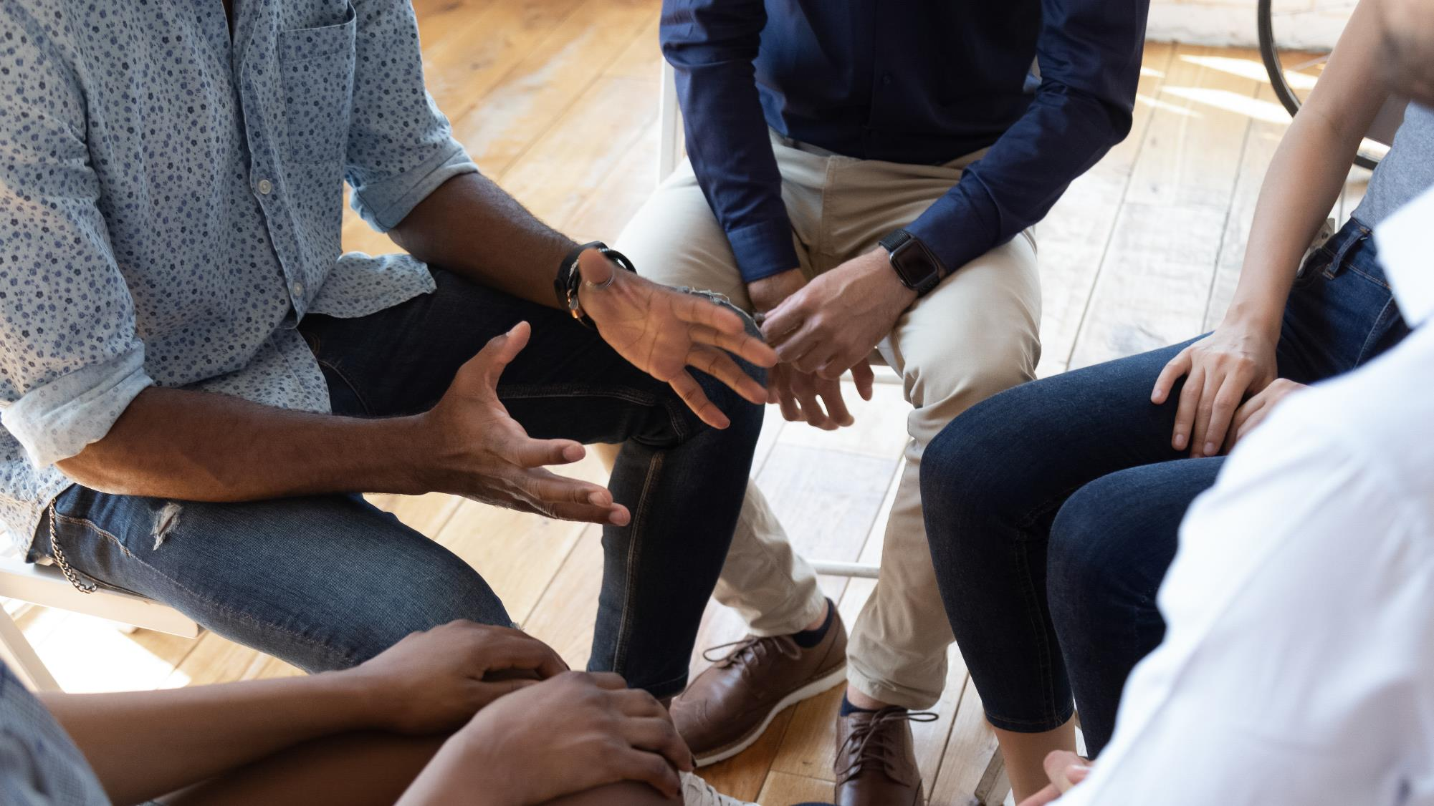


Part 4:

Slide 42
Men have learned (or learn very quickly) that when you ask for help, the world looks down on you as a man.
Jake

Slide 43
There is among many men the common belief that ‘real men’ don’t rely on others for help
Clearly, the association with weakness (and hence shame) is one of the most substantial barriers to men seeking help, and help seeking can be an admission of defeat
Many men feel like they are expected to be capable of shouldering their own burdens as well as those of others. Ergo, seeking help is equivalent to not being capable, so is not done.
Admitting to small things is also hard, because you are supposed to be able to sort them out yourself (with the added danger of being seen as ‘whining’). Therefore in admitting to any problem, it has to be serious by definition.
This is compounded by the fact that admitting a mistake is shameful in itself, particularly if public (e.g. showing up in bank statements). For most men this is tantamount to an admission of weakness.
Despite all the ads saying "it's ok to ask for help" and "it's not ok to hit your wife", men still don't seek help. Makes us look weak is the only explanation I can think of. Arnold
Men feel an intense amount of shame for asking for help, as the idea of masculinity is based in shouldering burden Reuben
So talking to your mate about how you feel is very hard because again you don’t want to come across as soft or weak. Dean
I don't know if the reasons would even be worthy reasons of why I'm feeling down and also scared of being thought I'm not handling problems well enough. Sean

Slide 44
Emotional vulnerability is particularly hard
Many men articulate that there are very few people they can be their ‘whole self’ with. And there is a notable lack of safe spaces to do so.
Most turn to their partners (particularly), mothers, mates (occasionally), fathers (rarely) : these people represent a safe place where they can be vulnerable. These are often associated literally and metaphorically with ‘home’.
Some men in the forum spoke of the impacts of breakups. Losing this safe place (person/home) is devastating. It is a threat – not merely loss of their outlet and comfort, but brings the threat and shame of vulnerability. Which is why they feel women’s reaction to vulnerability can be critical, particularly in the context of abusive behavior in relationships, as it involves the person they might normally emotionally rely on.
Some men see their vulnerability as the reason they have been rejected by women, or pinpoint their vulnerability as the cause of a break-up. This may be perception only, and may require research amongst women to have their perspective on this also.
Without a ‘safe place’, men’s experience can be very isolating, and may be risk factor in itself for mental health, physical health, loneliness and abusive behaviour - all which might be termed ‘diseases of emotional vulnerability’.
I feel society claims that it wants men to ‘open up’ and express themselves, yet if I encounter challenges in my life I'm supposed to ‘man up’. Reality is, no one wants to see your tears. I'm not saying don't cry. I'm saying cry in private. Vidu
A woman might want her man to open up about his feelings but then feel dirty and think less of her man for knowing it. Josh

Slide 45
Mates aren’t always all that….
Some men had close friend networks which they trusted enough to ask for help. But many men hesitated to ‘test’ their relationships, particularly since there is a taboo around talking about relationships in a serious fashion. It seems you can embarrass or harass your mates but you cannot make them feel uncomfortable.
Some of the men spoke of the abiding hurt caused to them by having their erstwhile mates abandon them at their moment of need, as their relationships or mental health crumbled. Or other times ‘being there’ for their mates and not having the favour returned.
There is a feeling that divulging problems to mates risks you becoming a burden – the implication is that your mate is obligated to ‘do’ something (rather than just listen). And no one wants to be the guy to ‘kill’ the mood by getting too heavy when their mates just want to unwind and have a good time.
Even though many men acknowledged that checking in with each other was now more common (driven by mental health concerns), some individuals spoke not just of hesitation in asking for help, but examples of failure of when they have. They don’t necessarily believe that their mates will have any of the answers.
Conversely, men who provided help to other men, often found it empowering. Some men, particularly the ‘Reformed’, went out of their way to provide it.
I've asked my mates for help, even just to hang out, and they've all scuttled away. Being sad can be contagious and they don't want to be sad. Arnold
Well obviously we can't just go and ask for help, it'll cost us our mates. Arnold
Personally, if I were to keep something to myself it would be to not burden people I care about with my drama. They have their own stuff to worry about, and I'd rather not add to it. Connor

Slide 46
Many men articulate a preference to handle it by themselves in their own way
Not surprisingly given these difficulties around help seeking, the men we spoke to talked of the instinct to fix problems themselves, figure it out, put their head down, work through it (no. 8 wire approach), or to simply ignore it in the hope that it will go away
The conversations with men in our study were littered with references to ‘do it yourself’.
It is ingrained in these men to wait it out until it gets ‘better’ or much worse, and ‘put duct tape over it’ for the meantime. It about short term goals – surviving through it rather than addressing it.
This approach not only sidesteps the potential social consequences of opening yourself up, but also has the side effect of reinforcing their sense of capability, allowing them to feel more like a man.
The flip side of this is, of course, isolation and the dangers therein.
One result of our DIY culture is that many men do not seem to reach out to others, professional or otherwise, until the situation has gone beyond the point of no return and after harm (to self and others) has already occurred.
Encouraging men to open up to these issues before crisis point is doubly difficult as talking about ‘trivial’ problems is seen as showing a lack of capability and causing unnecessary drama, both of which are discouraged by the man rules.
It was of my making in my mind so I had to fix it. Manaia
I personally do not want to bother others with my problems. Roshin
What I needed was someone to tell me that it was ok that I couldn't handle it on my own. Max

Slide 47
Added with a hesitation that many often don’t know how to address their issues
However, the DIY analogy for addressing problems only goes so far, as most DIY comes with an instruction manual, a set of tools, skills from experiences and a sense of what the complete outcome should look like.
When it comes with dealing with emotive issues, many men have none of these things. Many men are all at sea, trying to find their way through with few tools, skills or support to do it.
They don’t have the language to talk about these issues or a clear picture of what they want to achieve. Many still have uncertainty that the course they are embarking on will have a positive outcome and be worth the risk.
General culture is not a lot of help to men here. Most of the time, men are shown to address their issues in destructive rather than constructive ways – through the bottle, through anger, through negative risk taking. John Kirwan and his crusade for men’s mental health was seen as a positive antidote to this, but that can only go so far.
Most of these things or events looking back stemmed from either insecurities and fears that I was harbouring at the time and did not possess the tools for working through them. Immanuel
If you yourself can't even understand why you're feeling down and or what it is that you are feeling then it is even harder to try and talk about it. Sean
Many scenarios in media (TV, movies etc.) show that drinking alcohol, smoking, taking drugs are the alternative ways to get rid of the reality (life problems/issues). There are not much image showing men seek help from professionals. Boys and men may get the idea that seeking help from professionals is “uncool.” Dave

Slide 48
I think this is mostly because we are just emotionally illiterate. Imagine trying to describe a colour to someone who has never seen it before. You know what it’s like but actually putting it into words is more difficult than you’d think. Add on top of that the emotional stress from trying to describe it and it becomes almost suffocating.
Josh

Slide 49
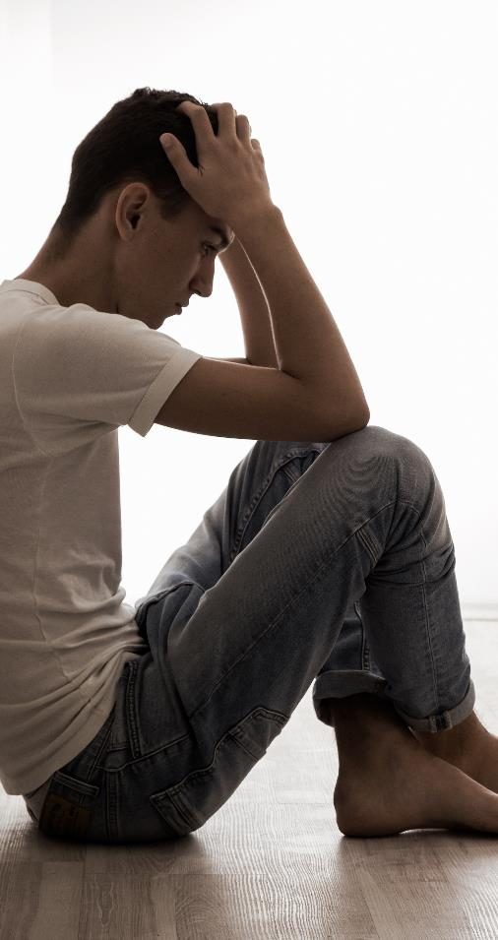
Two tipping points: the external crisis and the internal crisis
Opening up to others and seeking help, especially professional help was the last resort for most. When it happens it seems to centre around two tipping points.
One is a moment of external crisis – like when a partner threatens to leave, a relationship is in the throes of breakdown, or a partner takes kids and leaves. This is when men are left dealing with the overwhelming mental consequences, when being stoic isn’t going to cut it and they recognise they need help.
There also seems to be another tipping point which is centred around a moment of internal crisis. This seems to be the threshold at which individuals recognise that they cannot deal with things themselves – a moment urgent enough to suspend their reluctance about help seeking. This is precipitated by the realisation that their thinking and behaviour posed harm to themselves or to others. For men that are reflective and self-aware, they can identify changes to their thinking and behaviour and routine that may prompt them to stop and consider their wellbeing. Some men may heed the concerns of those close to them.
Men often described both these tipping points as hitting ‘rock bottom’. Circumstance forced them to confront their behaviours or attitudes - it became increasingly hard to ignore, rationalise and justify.

Slide 50
How they open up: testing the waters
Building trust is important. Many men talked about using a conversation process that tests the waters, where they would dip their emotional toes in first to determine the level of safety and caution they felt about proceeding. Not admitting things up front maintains an air of confidence and doesn’t show weakness.
How the other person responded was how they would determine whether they pursued this conversation or end it and possibly look elsewhere (or not). Multiple requests for help can be perceived as a character flaw (by others) and debilitating for self. But if it works, it encourages desire and confidence to keep going.
The things they looked for in the other (supportive) person were whether the other person ‘got them’, had a language or was articulate enough to engage in the conversation or provide meaningful support, was caring enough and didn’t come across as the labelling or stigmatising type, and was comfortable in listening (rather than jumping to problem solving).
However as the person opening up to others you MUST follow up with doing something to address the issue you’re talking about – otherwise it becomes self defeating and attention seeking.
Plausible deniability is one way that males can seek help without damaging their ego and pride as a male. This included the use of jokes and alcohol to defuse and excuse the act of help seeking.
Rule: if you want to talk about your emotions/problems you have to make a joke out of the situation first before discussing it openly. Call it the emotional shoulder price (ESP). The ESP is the price every guy HAS to pay before talking about his personal issues. its usually silently agreed upon that you leave your personal issues at the door before meeting each other. Josh

Slide 51
How they intervene: in packs
Men deal with their problems alone, but often help others in packs.
There is safety in numbers – men prefer to ‘intervene’ rather than help, and its easier to do this in numbers. There is a risk that intervening in a mate’s life can seem like an accusation, and doing this together spreads the risk. It may also get around the prohibition on inferring problems that aren't directly introduced by the man asking for help.
Men talk the language of solutions. There needs to be a problem to solve, a job to do - otherwise it just feels awkward. They recognised that there are whole heap of skills missing in these conversations. Often it takes someone who has been through it to be the one who reaches out.
But – if the intervention is successful, it can make all the difference, benefitting both the help receiver and givers.
It appears that help seeking is asymmetrical – most men seem more comfortable with offering help than seeking it. The best place to start may be by encouraging giving help.
After a while I shared with him a moment that my partner and I had gone through in order to share some of my feelings and experiences. His first reaction was "why didn't you tell me you dick!“ Manaia

Slide 52




Part 5:

Slide 53
It comes with so much shame, to hurt the ones you love, making it probably one of the most difficult things to seek help about.
Andrew

Slide 54
Fear of the ‘label’
All men did not want to go anywhere near something that they feel would label them.
They spoke of the fear of stigma and the sense of getting tarred for life, particularly in the context of abusive behavior in a relationship – the shame of admittance and public jeopardy of being “sprung” or “exposed”.
They instinctively understood how a behavioural act (such as abusive behavior in a relationship) could become lasting stain on someone’s public identity, and come to define them.
This image is a core part of their socially constructed identity and goes hand in hand with the fear of losing face. This was common to all respondents, with those from Asian cultures even more so.
Many men have invested a lot in creating an image of masculinity and competence, that the risk of being ‘exposed’ as not being so is terrifying – and hard to undo.
Not surprisingly, anonymity was desired by many, with discrete help seeking and no damage to reputation. Men articulate a preference for the idea of ‘support’ and understanding rather than ‘intervention’.
You cannot underestimate the stigma around non violence programmes. They worry about coming through our doors. Men’s practitioner
Losing public face is shame. Tony Veitch has never recovered from that. Anonymous triads respondent
They feel ashamed for their behaviour and don’t know how to fix it without someone giving them shit. Dave

Slide 55
Poor previous experience creates poor expectations of seeking help
The majority of men had little knowledge of what help seeking actually entailed, particularly help seeking of the professional type, which was a bit of an (off-putting) ‘black box’. The ‘first step’ in help seeking is a big unknown and a frightening prospect for a lot of men.
Personal experiences of help seeking were patchy, some having achieved good outcomes but many echoing sentiments that poor experiences of reaching out for help prevent men from doing so again.
Mental health is most people’s model. Quite frequently, their experience of getting help was quite poor, the help often not being there, being hard to reach or being too costly.
This leads them to question what the help for abusive behaviours would be like, whether the support would actually be there.
Men in this study verbalise wanting it to be actually OK to seek help rather than just reassuring that it is.
They perceive a gap between crisis response (police, courts) and talking response (some awareness of men’s groups). None of the men we directly spoke to would approach the police voluntarily for fear of outing themselves. Men who have experienced volatile relationships spoke of the need for ‘cool off’ support – a service or venue that that would allow for de-escalation of a situation in the moment.
If support is not robust and available the first time a man asks for help it can be very problematic. I feel like I need to wait for it to become unbearable before bringing up the same issues again. As if I need to actually boil over for it to be glaringly obvious that I need support. Ryan

Slide 56
Abusive behaviors toward intimate partners is –quite literally – unspoken
Admitting to or even acknowledging abuse or violence towards an intimate partner is still taboo. Some said that anyone who did would simply “be out of our crew”, and most men think of ‘support’ in terms of helping the victim of violence, rather than the perpetrator.
But what’s also clear is that they don’t have the words to talk about it even if they had the motivation to. The words “domestic abuse” do not relate – they do not reflect their lived or imagined reality. Nor do they want to identify – as ‘domestic abuse’ carries such a strong taboo.
Some men used terms such as ‘losing control’, ‘lashing out’, ‘over the edge’, ‘crossing the line’ and ‘hitting the missus’, which describe but do not explicitly name the act of abuse. These terms enable them to position the act in their minds as moment in time (compared to ‘domestic abuse’ which is ongoing), and with a root cause in which ‘something or someone else’ triggered the behaviour.
More study is needed to understand the natural language and appropriate conversational strategies that will allow men to open up to the subject area.
I know of men in my life that I suspect of hurting their partners, but it is treated as a taboo subject or assumption to make. Reuben
I think a lot of harmful behaviours by men towards partners are driven by insecurity. From seeing the effects of their harmful behaviours it causes them further negative emotion such as shame, guilt, and embarrassment which makes it even harder for them to seek support. Ryan
I would change some of the language from something formal like "violent behaviour" to something more relatable like "hitting the missus" or along those lines. Tane
When intoxicated, these menial arguments turned into fisty-cuffs. Manaia

Slide 57
There is a degree of private empathy for men who have done harm to their partners
All agreed that men who have harmed their partners are universally and publicly condemned.
However, privately there was some degree of empathy for the pressures that men are withstanding, and some attempts to understand what an abusive man has gone through that result in his behaviour. This seemed to relate more to their struggles with being a man rather than explicitly blaming the victim.
However, this empathy is not given freely. It seems to be conditional on whether genuine remorse and desire for change is exhibited by the perpetrators. Empathy can feel very close to condoning the behaviour if it is not associated with remorse.
That sort of violence or emotional control originally comes from them not managing things in a healthy way. If it gets out that's happening, they will feel weak for not acting properly and really ashamed. I feel sometimes like everyone is winging it, hoping we're doing things right. Murphy
I think they don't try to stop because a part of them feel its justified abuse and think they are doing nothing wrong and the stigma attached to harming or abusing a female if it was to be made public. Kei
[He] needs to be instantly regretful and if not, I don’t give a shit about [him] – Fuck him! Anonymous triads respondent

Slide 58

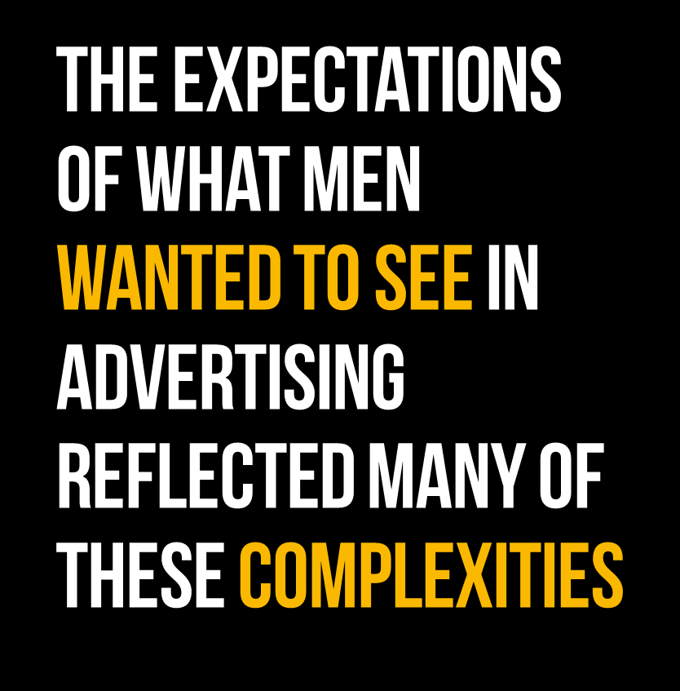
We asked men to come up with their ideas for advertising that would encourage men to seek help if they are harming their partners.
Those who are more sensitive to weakness spontaneously suggested ideas that reassured men that help seeking did not make them less of a man.
Those who were more assured suggested messages around how it made them more of a man.
Most had a degree of empathy for the man involved (without condoning the behaviour).

Slide 59
Spontaneous advertising messages by mindset
Reformed | Alternative | Performer | Lost | Resentful
Overcome - Weakness can sometimes be strength | Disengaged - Weakness can be acceptable | Invested – Absence of weakness is a success | Buffeted - Weakness is an exploitable vulnerability | Trapped - Weakness is an exploitable vulnerability
Behaviours confronted, but getting help makes you a better man. | Empathy and reflection. Becoming stronger by seeking help. | Strong men who are denying their issues, appeal to their conscience in an empathetic way. | Support and reassurance, individuals in the context of their friends and community. | Self reflection and realisation of impacts.
“Message would be ‘be Better’“ “What kind of man do you want to be" | “It is alright to ask for help” “Apologizing and accepting ones mistake takes courage and strength” | “We know you love her, we know you want to do things better, we're here to help”. “You are a bloody legend if you respect your partner and have a positive family dynamic.” | “It's a masculine thing to ask for help when you're harming your partner, and that you deserve the right to be helped for your problems without judgement. “It’s ok to ask for help, it's ok to ask if you're unsure." | “You are not less of a man for reaching out“ “He realised that all these "manly" things he did hurt the people that he loved”
Relation with man rules and weakness
What they wanted (pre ad concept exposure)
Messages and ideas in their words

Slide 60

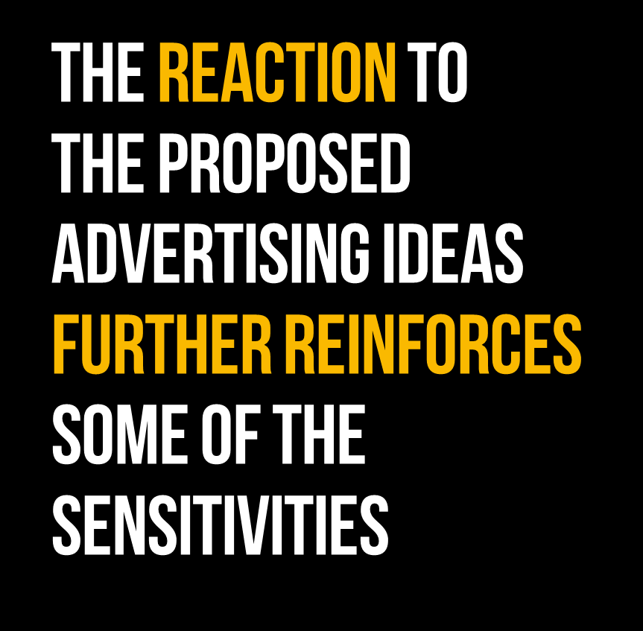
The depiction of internal struggles, and the fear of being isolated as the result of seeking help resonated widely with the men in our study.
However, this did also reveal a double edged sword. Depicting protagonists as hesitant, was generally interpreted as weakness, and hence did not help identification. They need to be seen as strong man from the outset.
For those sensitive to weakness, they easily got to an interpretation of the communication where they see ‘men’ defined as the problem.

Slide 61
Response to proposed advertising ideas by mindset
Reformed | Alternative | Performer | Lost | Resentful
Overcome - Weakness can sometimes be strength | Disengaged - Weakness can be acceptable | Invested – Absence of weakness is a success | Buffeted - Weakness is an exploitable vulnerability | Trapped - Weakness is an exploitable vulnerability
The will to overcome his demons and ask for help. Reality of seeking support. | Won’t resonate with ‘hard men’ seems more targeted for conflicted types but internal struggle relates. | Potentially a bit feminine, weak but the internal battle resonates. | Relatability of internal struggle. Some sensitivity to portrayal of perceived judgement. Positive outcome | Complex response: Not enough questioning of behaviour, for some. Sensitivity to denigrating men or showing potential judgement.
He needs to be brighter. the Champion. the Hero. | It depicts the man as weak and feebly. [What] will resonate with men is the representation of an internal struggle and the different ideas we tell ourselves in challenging situations. | He's contemplating the right thing, he wants to be better, he's just deeply ashamed. He shows he is strong enough to break though the negativity. | A little threatening in the way it portrays the reactions of other people. The weakness in him should be replaced and he should give the impression of being a "hero", for making the right decision | I can imagine it but I don't feel that it is powerful enough to get the message through
Relation with man rules and weakness
What they saw (post ad concept exposure)
Response in their own words

Slide 62
Any suggestion of shame risks deepening the shame
By attempting to recognise – and reassure - around barriers associated with weakness and shame, the risk is that those barriers get further cemented in men’s minds
Men know that abusive behaviour is shameful and will bring them shame. That’s why it is kept private. Anything that increases the shame by making it more ‘ugly’ is unlikely to bring men forward.
Pointing the finger at the hesitation and the abusive behaviour gets many men no closer to wanting to fix the issue.
There is also the sense in their response that if we define abusive behavior as who they ‘are’ rather than as the part that needs work, we lose some men as they don’t see the recognition of all the other things that they reckon they’ve been working hard on.
It kind of resonates with the exact reason on why men won't talk out, confirming if they speak out about what they have done, that they would be outcast from friends and such. Because of this, while it resonates with men it also reaffirms their thoughts and while the ad does turn in the other direction and is confronting and helping, it may be difficult for some to look past the initial message which was that if they speak out they will be judged. Murphy
I also don't like the suggestion that abusers and other men with serious problems are broken people. "Unfixable" or "fixable". I think this would make men defensive - "F that, I'm not broken, I have problems but I'm still in control of my life". I would rather see it saying that every man should try and be the best man he can be whether or not he's broken. Jake

Slide 63
Nobody wants to be the bad guy in their own story so we look for excuses to make ourselves feel like either the hero or the victim.
Jake

Slide 64


Part 6:

Slide 65
Frame can be ‘Everything to Gain’, it’s more toward the positive
Dean

Slide 66
There is a way out
Our notions of masculinity are both the problem that holds many men back and the solution of how they can move forward.
No man wants to be associated with being the bad guy. But many men spontaneously wanted to be depicted as heroes.
The ‘Rules’ are the blueprint for how they can do this.
Everyone likes to see themselves as the hero of their own story, and anything that doesn't align with that world view is disregarded without much thought. Connor
The weakness in him should be replaced and he should give the impression of being a "hero", for making the right decision. He should be rewarded with a little wave of relief. Ryan

Slide 67
They don’t want to see the spectre of weakness, they want to see what there is to gain
EMERGING DIALOGUE: EVERYTHING TO GAIN
Addressing strengths promotes identification
Capable
Control
Provider
Protector
Solidarity
Uncomplicated
Disappointed expectation
Exposure
Humiliation
Failure
Exclusion
‘Drama’
CURRENT DIALOGUE: TOO MUCH TO LOSE
Addressing fears risks reinforcing those fears

Slide 68
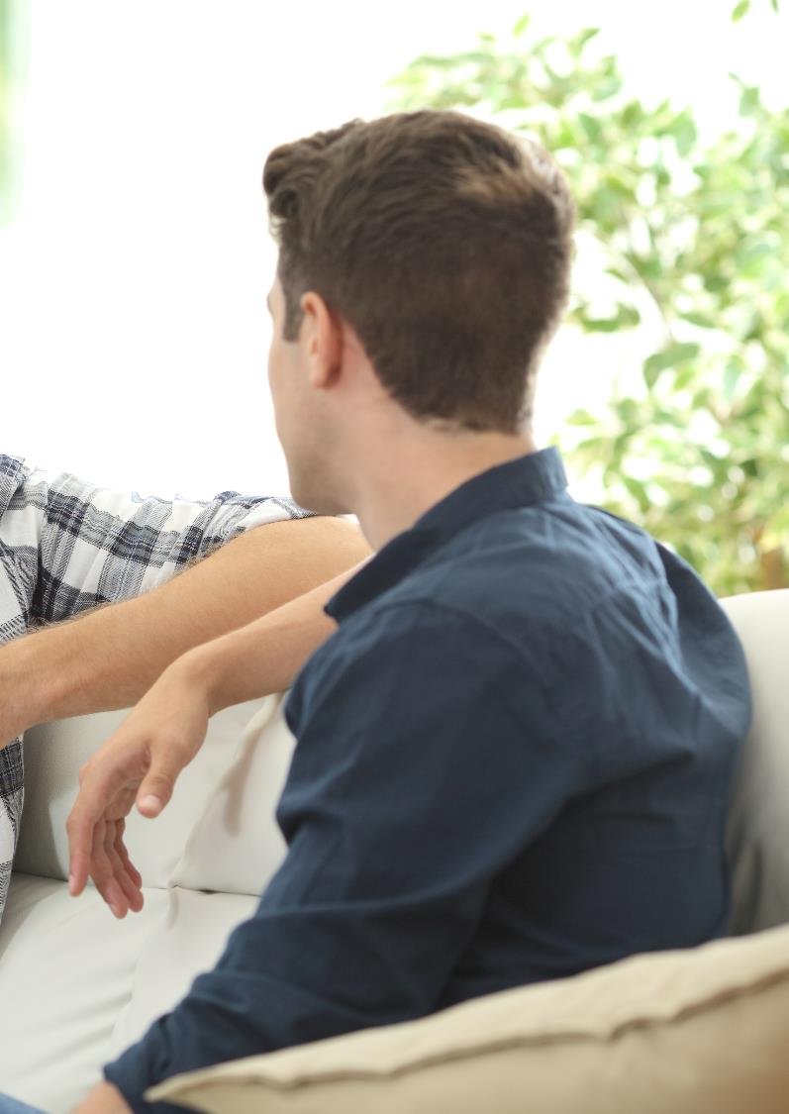

Framing the message to be positive with an emphasis on you and your mate’s well being. It needs to be different from the current adverts which generally portray men in a negative light (i.e. domestic violence). Tane
Flipping it on it's head and framing domestic abuse as a sign of weakness makes it a lot more impactful for the guys who've gone their whole lives trying to avoid showing weakness and show themselves as strong men. Ilijah
I think if the help appeared more like "improve your mental health" and less like "we will feel sorry for you“. Leo
I think its cowardly to run away from your emotions and to clam up like a baby in fear of being kicked. Better to embrace the pain and master it than to run and get cut down instead. Josh
“Shift the focus towards trying to improve, trying to be higher up on the continuum. I think the "help" could be more like a gym, and you had a personal trainer for your mental health.” Leo
Becoming stronger by seeking help. Murphy

Slide 69
This flip spontaneously reflects the cherished male qualities
A good outcome from seeking help, ie better relationship with partner, kids, mates and peers. Miles
Men are attracted to challenge and discipline. Leo
It made me feel empathetic giving help, I felt useful, purposeful in fact. Ilijah
Capable
Control
Provider
Protector
Solidarity
Uncomplicated
A strong man controls his emotions. A weak man lets his emotions control him. Ilijah
Men need to work together to lift ourselves up - maybe an appeal to brotherhood? Jake

Slide 70
This is echoed in how “Reformed” men talk
The men that we spoke to who had ‘reformed’ attitudes had markedly different dialogue to many of the other men.
A core theme of strength and effort rang through their responses. Specifically:
They saw themselves as a project and valued the work they have put into themselves and felt pride in what they had achieved and overcome
They talked about their responsibility as men
They eschewed soft language preferring concrete, strength-based terms e.g. courage, responsibility, push
They recognised that helping others in similar situations is empowering
There was a confidence and empowerment they displayed from having the tools and the language to confidently communicate about men. They explicitly referred to and used ‘tools’
That makes it so important is that we push each other to be the best versions of ourselves. Andrew
You still have to have courage to call it out and do what is right for yourself. You have to develop yourself consistently Dean
I have a few Facebook group chats and we always use it to vent and discuss things, its actually a really useful tool Ilijah
Seeking help its just like going to a DIY expert who can help give you the tools you need to work on the most important project in your life - YOU. Julian
I've done a lot of work in breaking them down. ….I take great responsibility in modelling positive masculinity, which includes breaking down these rules. Andrew

Slide 71
Bro, I can see you’re hurting, and we are here for you. But you can’t keep treating her like this. I think its time to ask for help brother
Andrew

Slide 72
There’s a real need for stories that have hope and illustrate the process of change
There was a sense amongst the ‘Reformed’ men that they were their own role models of positive change. For others, stories of change, and the belief in change that they engender, were currently missing.
Men told us that messaging that comes with judgement is not helpful. Instead, they wanted a greater sense of ‘we are all in this together, we all go through stuff, you can get through it and there is hope at the other end”
What they needed to hear was:
Men can change
There is hope
This does not define you, don’t let it be you
Let’s understand how the behaviour came about
You can work through it, It’s fixable
You will be a be better man.
At a deeper level, our society also needs to get better at presenting masculinity not as a binary (either/or strong/weak), nor as a vague third way (neither strong or weak) but rather as a powerful celebration of the combination of both.
Men are looking for expressions of their cake and eating it. They want to see guys who can banter but also stepping up and being serious. They need to see the compassionate dad and also strong guy who supports his whanau.
He's contemplating the right thing, he wants to be better, he's just deeply ashamed. I think that sense if being brave and making the change will resonate with how modern, particularly younger, men see manhood is changing. Murphy

Slide 73
There’s also a need to help men create and keep better relationships
There’s also a real need for help around relationships. Most men recognise that they are poorly equipped when understanding relationships.
But that relationships are important to them, vital even.
Their ideas included:
Teaching boys how to interact with women from a younger age, especially about relationships with women.
Learning in later life about being a good partner.
Showing how the outcome from seeking help is a better relationship with their existing (or future) partner and those close to them.
Involving the partner in the abusive partner’s journey to being a better man.
A good outcome from seeking help, is better relationship with partner, kids, mates and peers…something to aspire towards with your loved ones rather than starting again. Miles
They love their partner. 99% of them will be in love with their partner and deep deep deep down will wish things were functional without the violence Murphy
As a man I was never really taught what it means to be a good partner, I had to figure it out myself. Manaia
“We never learned how women operated, and men don’t have a softer side, so you need to teach men from the get-go about how to deal with frustration and anger”. Troy
Targeting our rugby clubs or boys colleges with programmes or training days that can teach them about their thoughts and feelings and ways to work through them Tane

Slide 74


Part 7:

Slide 75

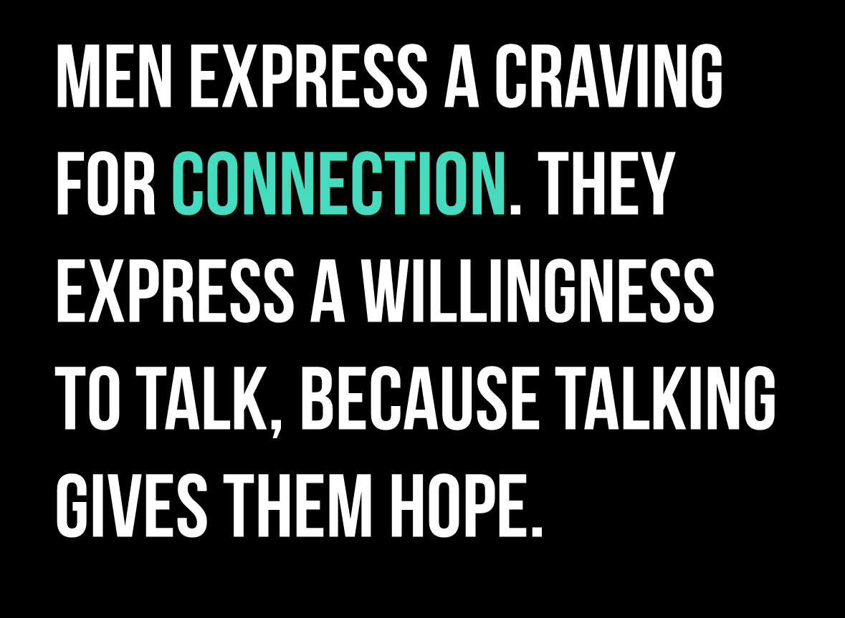
The sense of relief of being able to air their issues – without judgement – was palpable.

Slide 76
“Thank you for helping men”
Through the medium of our conversations, the men in our study were able to ask questions of themselves, examine their own responses and reflect upon their conditioning in a way that few had ever been able to do so.
It is clear that men want to be helped with men’s problems. They see a need - and once given the space – relish the opportunity to talk. Many of the men we spoke to wanted to continue the conversation and a few even spoke about setting up their own community action groups.
Men want the focus on them, in a positive way. This helps point to the way forward
“A big thank you to the team who are trying to help men” Jack
Plant the seed in their mind and then keep that conversation going year after year to make that seed grow. Murphy

Slide 77


Changing masculinity will be held back without empathising with the struggles of men
Nearly all the men we spoke to when asked what would need to change to encourage men to seek support described some type of empathetic approach; non-judgemental and understanding.
Many feel ‘got at’ as men. This points to their desire to solve problems from a male point of view, using men’s solidarity as part of the solution. This may indicate that movement on issues such as abusive behaviour could be eased through the lens of men ‘sorting their shit’, in parallel with the current victim-centric lens.
Clearly this has its challenges, but loud and clear throughout our conversations, we heard the desire for our society to better empathise with the realities of men. If we want to ask men to change or challenge masculine norms, it starts with understanding and empathising with how these norms are affecting men too.

Slide 78

Everything to gain
The risks involved in seeking help for abusive behaviours (loss of face, being cast out by your mates, losing your kids) loom large, and the gains are minimised or simply unknown. Many men describe this as ‘everything to lose’ and the upside of seeking help are difficult for men to articulate, other than ‘sorting their shit out’.
All men want to appear strong before themselves and before others – so redefining help seeking as a path to growth as a man for the sake of themselves and their close relationships in their lives (and not just the cessation of a harmful behaviour) appeals more to men’s innate willingness to see themselves as a project to work on.

Slide 79

The same man rules, applied differently
The man rules are at the core of what it means to be a man. They infuse how men measure their worth, how they relate to others and how they behave. They have been around for a long time and are here to stay.
The challenge will be how to apply these rules in a modern context, and use them to redefine notions of masculinity and strength. All men want to be strong and capable – however they need to be shown how to be strong and capable, through using the man rules, in healthier, more fit for purpose ways.

Slide 80

A language to use, and a tool kit to apply
The discussions we had with men made it clear that men know that all is not quite right with men. They talk about their own struggles, and of the struggles of their mates.
By and large, there is a willingness to talk about these issues but a lack of understanding of how to do so.
Most men simply don’t have the language or the toolkit to know how to approach these conversations with their mates, their whānau and their partners. Some are trying and with varying degrees of success – but others chose not to risk trying at all.
What many men desperately want is to be given a blueprint of how to begin the conversation and some permissibility.

Slide 81
I think we all know the answers, we just need to be brave enough to start the conversation.
Andrew

Slide 82
Questions/ comments?
Please contact kathryn.robinson@colmarbrunton.co.nz

