Slide 1
Rules about counting time for claims about abuse in State Care
Here is some information about the way time is counted in claims about abuse in State Care. This does not tell you everything that you need to know. For example, there are special rules about making claims against more than one ministry. You might want to ask a lawyer for more information.
Limitation Act:
In New Zealand there is a law called the Limitation Act. This law says that there are rules about how much time you have to make a claim in court. People need to make their claims as quickly as they can. If they take too long to make their claim, they might run out of time.
Imagine there is a clock that counts time during your claims process. Some things:
‘Start the clock’ counting time.
‘Stop the clock’ counting time. For example, the clock usually stops when you make your claim in court.
The rules about which things ‘start the clock’ and which things ‘stop the clock’ are complicated. If you decide to make your claim in court, the rules about time are very important. A lawyer can tell you about these rules.

Slide 2
2. Limitation Policy for claims about abuse in State Care:
This is a special policy about the way time is counted in claims against the Ministry of Social Development, Ministry of Education or Oranga Tamariki. This policy gives you suspension periods during your claims process (time that is not counted if you end up taking your claim to court).
For example, as soon as you make your claim to the Ministry of Social Development, the Ministry of Education, or Oranga Tamariki you get a suspension period – the clock stops counting time. This gives you some time to talk to the Ministry of Social Development, the Ministry of Education, or Oranga Tamariki about your claim.
Some things can make the suspension period end. If the suspension period ends, the clock starts counting time again. You might want to ask a lawyer for help with how the Limitation Policy will work for your claim.
You make your claim
Your claim is assessed
Suspension Period - This time is not counted

Slide 3
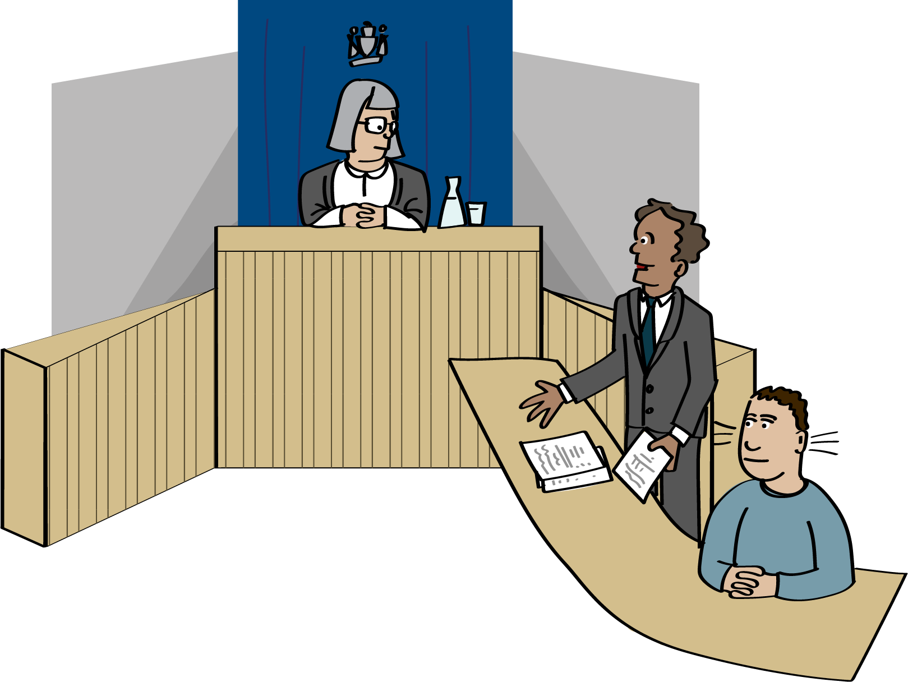
Most of the time the Ministry of Social Development, Ministry of Education and Oranga Tamariki will stick to the rules about counting time. But when there is a really good reason they might be able to do things differently to help you. For example, they might give you more time to decide what you want to do when you get a response to your claim.
If you are not happy with the response you receive at the end of your claim process with the Ministry of Social Development, Ministry of Education and Oranga Tamariki, you can say “I don’t want to settle my claim.” You can say “I want to take my claim to court.”
If you decide to take your claim to court, the suspension periods are really helpful. They mean that:
The time you spent talking to the Ministry of Social Development, the Ministry of Education, or Oranga Tamariki is not counted.
Taking your claim to the Ministry of Social Development, the Ministry of Education, or Oranga Tamariki does not disadvantage you – it does not make it harder for you to make your claim in court.

Slide 4
Claims about abuse and neglect in State Care - What things ‘start the clock’, what things ‘stop the clock’?
The abuse or neglect happened
You make your claim Your claim is assessed
You think about their response You decide what you want to do
If abuse or neglect happened to you when you were a child –
the clock usually starts counting on your 18th or 20th birthday.
(This is because we know that children need more time to make claims.)
If abuse or neglect happened to you when you were an adult –
the clock usually starts counting on the day the bad thing happened.
People work on your claim.
They talk to you.
They look at their files.
They think about what you say.
They send you their response.
Response = Their decision.
Yes, We want to make you an offer. (This might be an apology, money, or something else.)
No, we don’t think we need to make you an offer.
Try to make your decision within 6 months.
If you take longer than 6 months the clock starts counting again
1 | 2 | 3 | 4 | 5 | 6
You can decide to:
Settle – Yes, you are happy with the decision.
Ask for a review – No, you are not happy with the decision. You want them to look at your claim again.
Court - No, you are not happy with the decision. You want to take the claim to court.
Try to make your decision within 6 months.
After 6 months the clock starts again.
BUT you can still tell them what you want to do.
1 | 2 | 3 | 4 | 5 | 6
The clock starts
The clock stops
(Suspension Period)

Slide 5
Asking for a review - What things ‘start the clock’, what things ‘stop the clock’?
You ask for a review within 6 months
They say: “No. You don’t meet our criteria for asking for a review”
1 | 2 | 3 | 4 | 5 | 6
You have 6 months to think about what you want to do
e.g., take your claim to court.
Try to make your decision within 6 months.
After 6 months the clock starts again.
BUT you can still tell them what you want to do.
1 | 2 | 3 | 4 | 5 | 6
They say: “Yes. We will do a review”
1 | 2 | 3 | 4 | 5 | 6
People work on your claim again.
They talk to you.
They look at their files.
They think about what you say.
They send you their response =
Their decision.
What they think about your claim.
You have 6 months to think about their Response. You can say that you want to:
Settle – Yes, you are happy.
Court - No, you are not happy with the decision. You want to take the claim to court.
The clock is still stopped
The clock starts
(Suspension Period)

Slide 6
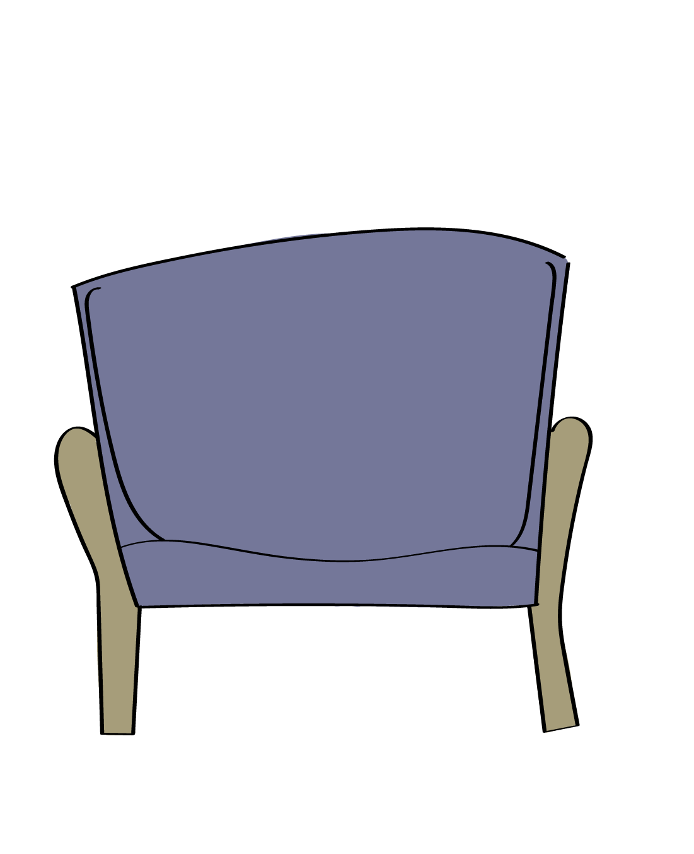
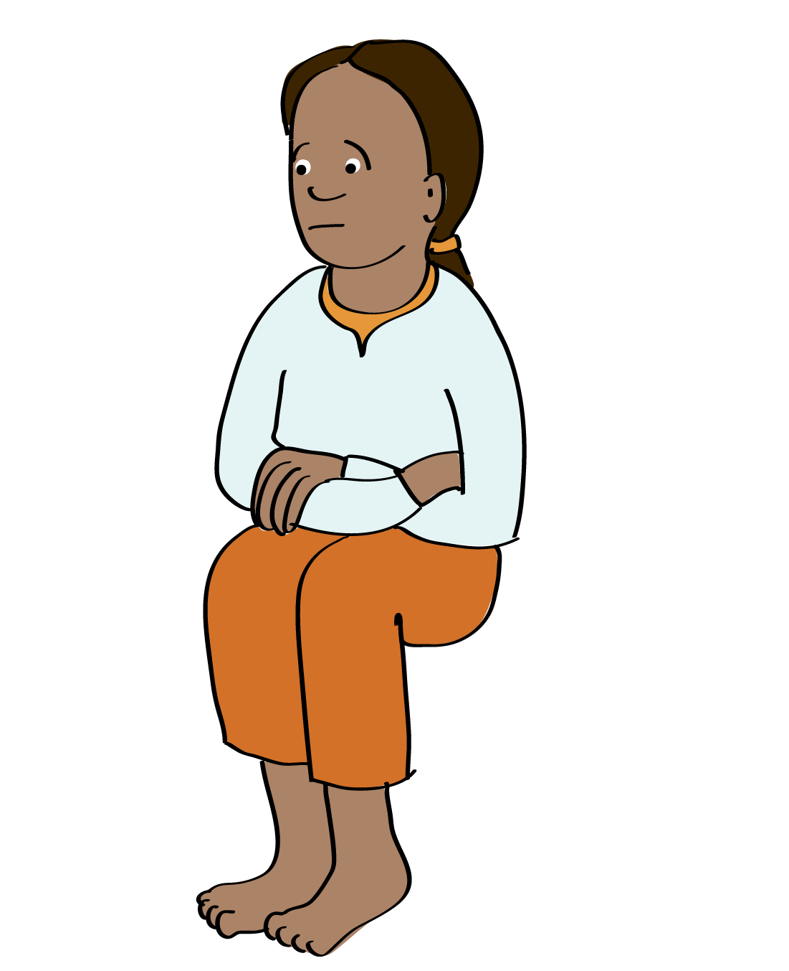
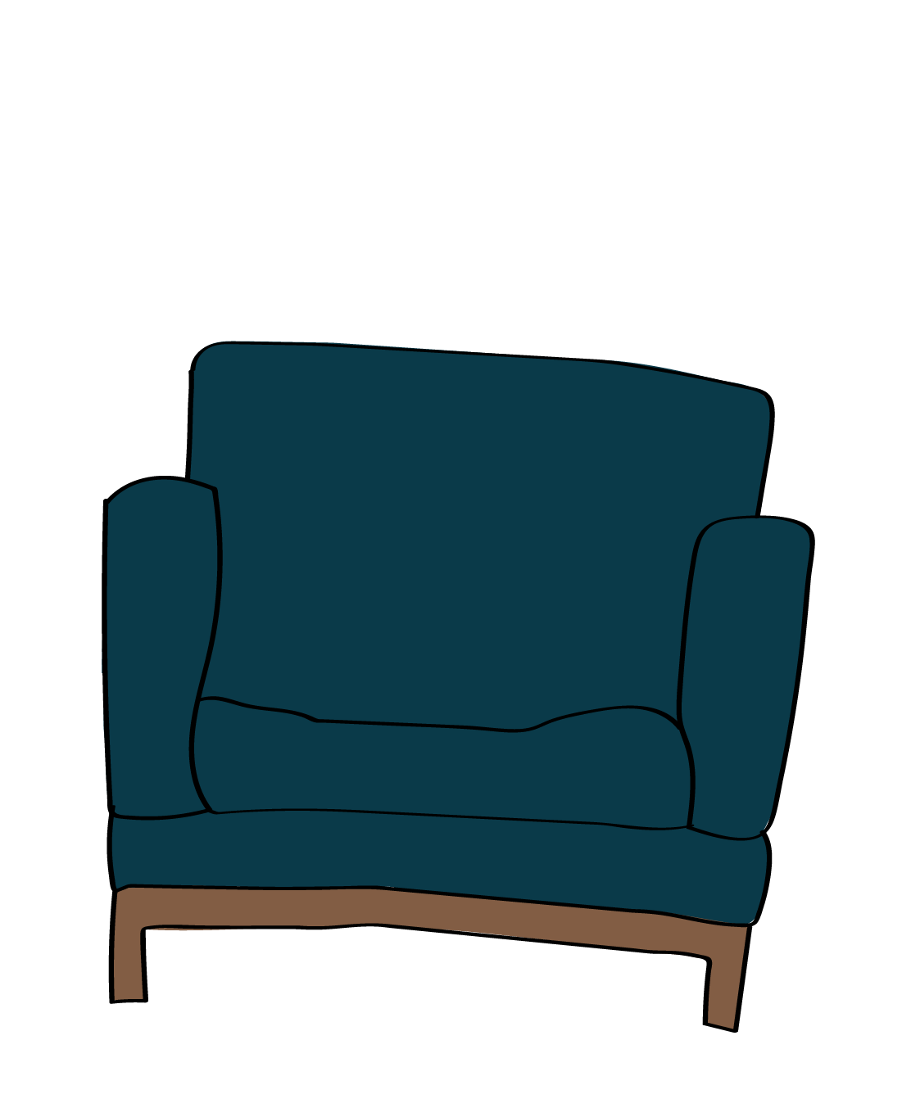
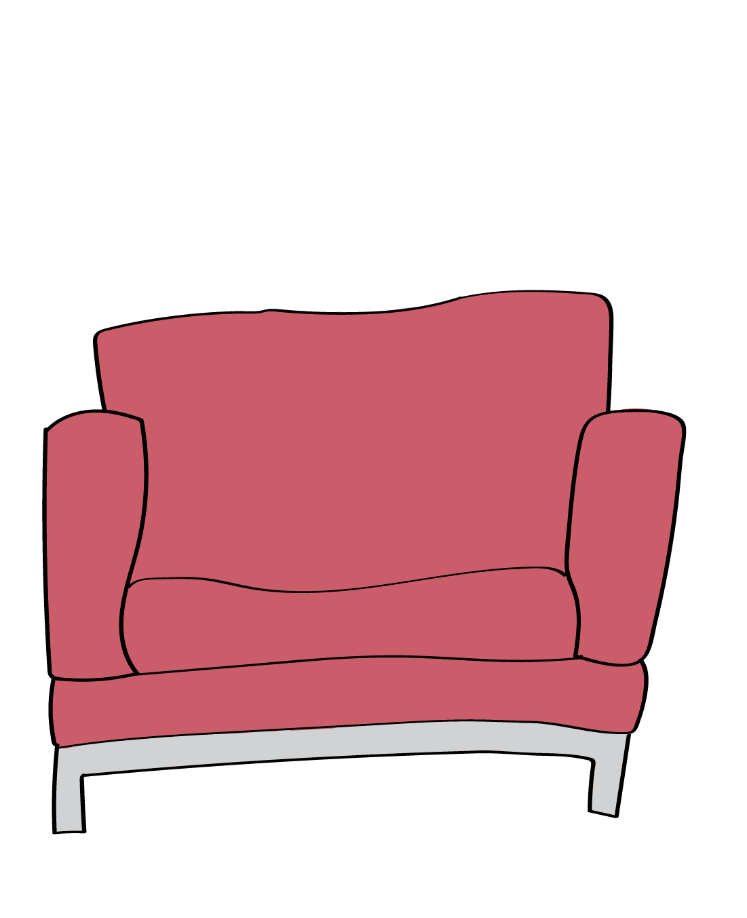
Example 1
Helen makes her decision in
less than 6 months
Helen makes her decision in
less than 6 months
20 February 2019
Helen calls MSD (Ministry of Social Development).
She makes her claim.
She says she was abused in foster care.
The clock stops counting time.
20 November 2020
Helen talks to MSD.
She gives them more information about what happened.
30 January 2021
Helen talks to MSD.
She gives them more information about what happened.
27 April 2022
MSD sends Helen their response = their decision about her claim.
Helen has 6 months –
27 Apr – 27 Oct 2022 to think about what she wants to do. She can:
Settle – Yes, she is happy with the decision.
Ask for a review – No, she is not happy with the decision. She wants them to look at her claim again.
Court - No, she is not happy with the decision. She wants to take her claim to court.
3 June 2022
Helen asks for a review.
15 January 2023
MSD sends Helen their decision about the review.
Helen has 6 months -
15 Jan – 10 Jul 2023 to think about what she wants to do.
She can:
Settle – Yes, she is happy with the decision.
Court - No, she is not happy with the decision. She wants to take the claim to court.
5 March 2023
Helen decides to take her claim to court.
She makes her claim in court within 6 months.
1 | 2 | 3 | 4 | 5 | 6
1 | 2 | 3 | 4 | 5 | 6
The clock stops for all of this time.
This is called a Suspension Period.

Slide 7
Example 2
Harry takes more than 6 months to make his decision
20 August 2021
Harry calls MOE (Ministry of Education).
He makes his claim.
He says he was abused at a Residential School when he was a child.
The clock stops counting time.
30 July 2022
Harry talks to MOE.
He gives them more information about what happened.
7 February 2023
MOE sends Harry their response = their decision about his claim.
Harry has 6 months
7 Feb – 7 Aug 2023 to think about what he wants to do. He can:
Settle – Yes, he is happy with the decision.
Ask for a review – No, he is not happy with the decision. He wants them to look at his claim again.
Court - No, he is not happy with the decision. He wants to take his claim to court.
8 August 2023
Harry is still thinking about what he wants to do.
The six months is over.
Harry can still tell MOE what he wants to do.
But the clock is counting time again.
Harry can stop the clock if he makes his claim in court.
3 April 2024
Harry asks for a review.
The clock is still counting time.
10 December 2024
MOE sends Harry their decision about the review.
He can:
Settle – Yes, he is happy with the decision.
Court - No, he is not happy with the decision. He wants to take his claim to court.
The clock is still counting time.
11 Feb 2025
Harry makes his claim in court.
The clock stops again.
1 | 2 | 3 | 4 | 5 | 6
1 | 2 | 3 | 4 | 5 | 6
7 | 8 | 9 | 10 | 11 | 12
The clock does not count any of this time.
(The Suspension Period)
The clock starts counting time.
The clock will stop again if Harry makes his claim in court.

