Slide 1



Top 10,000 Clients - Social Sector Costs
Presentation by the Social Development Minister

Slide 2
Top 10,000 work was a foundational piece of work in the social sector
A new approach to looking at shared clients
  Driven by the need to understand costs and liability (investment approach) and
  Used integrated data from social sector agencies
Provides insights into shared clients across the social sector
A foundational piece for Social Sector Investment Change Programme (Budget 2016)

Slide 3
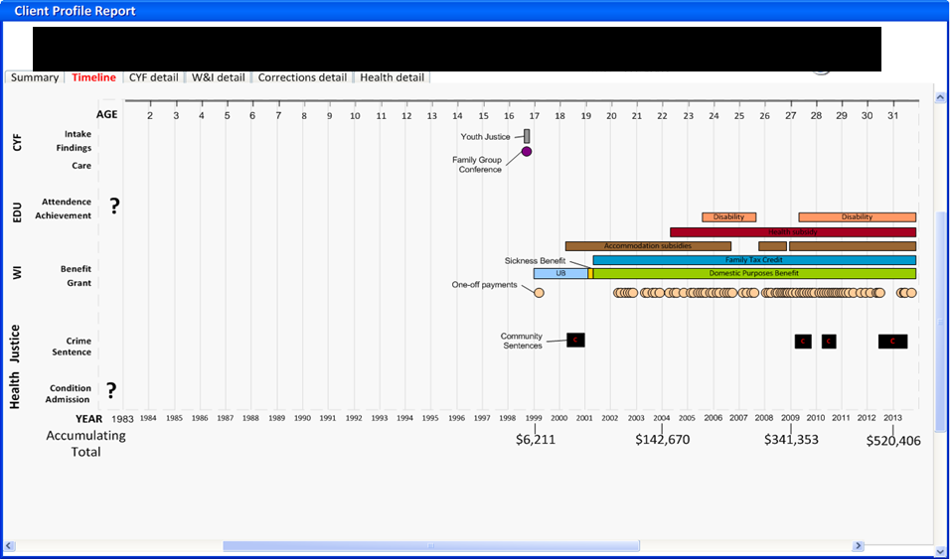
Single Client View of “Amanda”

Slide 4
When a child had contact with CYF between 1994 and 2014, what was the cost across the social sectors?
From 1994 to 2014 the total cost for the 10,000 highest cost clients was $6.5 billion
We used costs from following sources:
Source | Period of data
Child, Youth and Family | 1994-2014
Work and Income | 1993-2014
Corrections | 1900-2014
Health | 2007-2011

Slide 5

So what is the data telling us?
From 1994 to 2014:
  Each of the 10,000 clients have costs of at least $400,000
  920 clients have costs over $1 million
  The distribution of health cost is highly concentrated for disability services, and mental health and addiction services

Slide 6
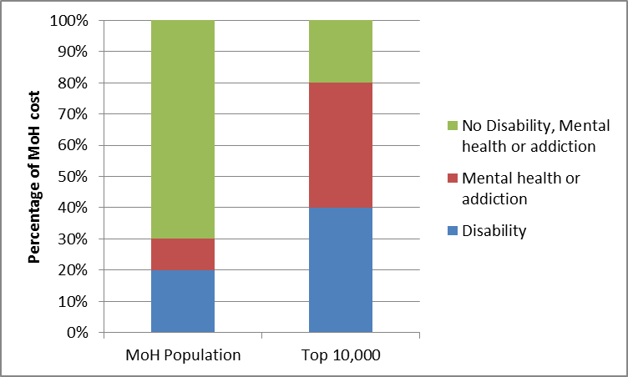
A focus on the health costs of shared clients

Slide 7
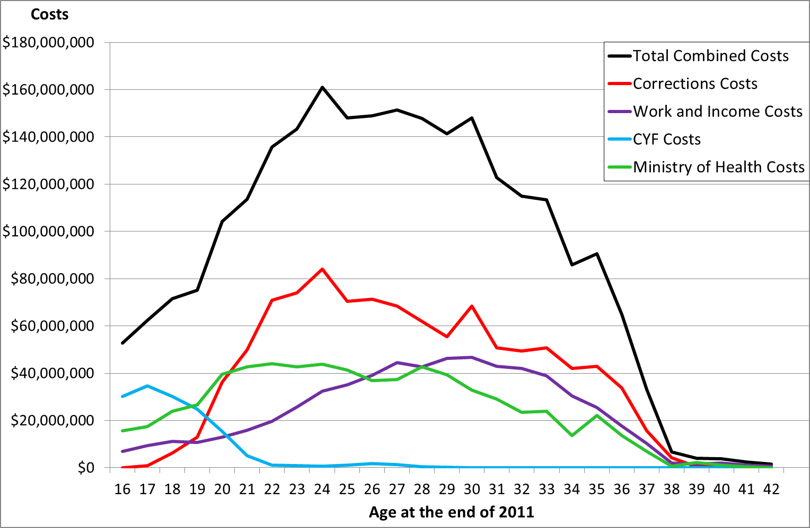
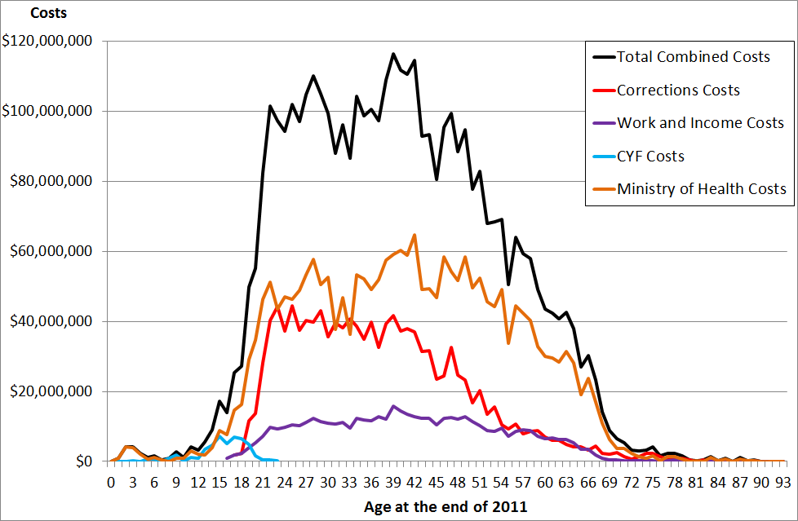
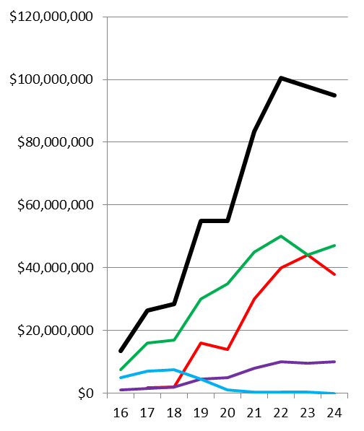
The Top 10,000: Costs between 2007 and 2011
The “shared client” cost question
Top 10,000 (CYF)
Top 10,000 (General)

Slide 8
Insights of Top 10,000
There are 10,000 users of services that attract a lifetime cost of over $400,000. This is likely to be an undercount, due to data constraints.
Mental health, addiction and disability costs are over represented in the Top 10,000 when compared to the MoH population.
If you want to allocate the investment according to the cost of outcome, CYF history is important.

Slide 9
Breakdown of main benefit types
Benefit Type | Proportion of Top 10,000 | Proportion of all the rest
Sole Parents | 56% | 43%
Job Seekers | 21% | 30%
Health/Disability | 20% | 22%
Others | 3% | 5%

Slide 10
Gangs and Top 10,000
6% of Top 10,000 were known gang members
15% of all gang members are in Top 10,000
25% of gang members aged 16-42 are in Top 10,000

Slide 11
Going forward
How do we optimise our intervention choices to achieve better life outcomes?
CYF investment approach
Social Sector Investment Change Program
  Introduces a fundamental change to the way the social sector works together for our most vulnerable clients
  For Budget 2016:
    Youth funding review for 15-24 year olds
    0-5 year olds priority population

Slide 12
0-5s – one of the priority populations for Budget 2016
Children under 6 years at 30 June 2012 by number of the following 4 risk factors present in their life to date
0-5 year olds with 2 or more of the following risk factors:
  CYF finding of neglect or abuse
  Caregiver with a Corrections history
  Long-term benefit receipt of the caregivers
  Mother with no formal qualifications.

Slide 13
Takeaways…
We see the same patterns whether we analyse cost liability or we analyse the risk of poor outcomes – this analysis identifies the important pathways to intervene, but not the types of intervention
Reducing the flow of CYF children into Corrections would have the biggest potential impact on future liability

